Slide 1
65th Sitting of the Committee of Plenipotentiary Representatives of ICSTI Member States
Improving Access to Nuclear Information
Role of the International Nuclear Information System (INIS)
Dobrica Savić
http://goo.gl/9j5E15

Slide 2
Contents
IAEA and the Nuclear Information Section (NIS)
International Nuclear Information System (INIS)
  Information collection
  Information preservation
  Information sharing
Impact of current trends on INIS
  Social trends
  Technological trends
  INIS relevant trends
INIS road ahead
65th Sitting of the Committee of Plenipotentiary Representatives of ICSTI Member States, 6-7 November 2014, Moscow 2

Slide 3
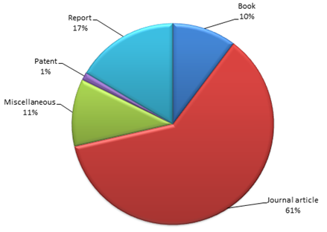
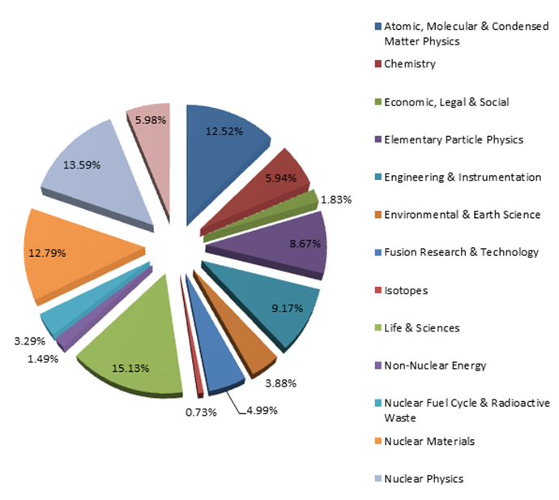
INIS Collection
Bibliographic records by literature type
Bibliographic records by subject category
Conventional literature 71%
  Journal articles 61%
  Books 10%
Non-conventional Literature 29%
  Reports 17%
  Miscellaneous 11%
  Patents 1%
65th Sitting of the Committee of Plenipotentiary Representatives of ICSTI Member States, 6-7 November 2014, Moscow 3

Slide 4
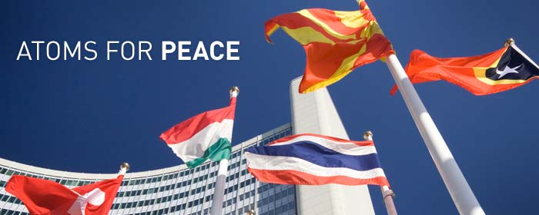

IAEA and Nuclear Information Section
International Atomic Energy Agency (IAEA)
  The world's leading Agency for cooperation in the nuclear field
  Created in 1957 as part of the United Nations family
  The IAEA works with its 159 Member States and multiple
  partners worldwide to promote safe, secure and
  peaceful uses of nuclear technologies
  The IAEA Secretariat is based in Vienna, Austria, with 2300
  multi-disciplinary professional and support staff from more than 100 countries
Nuclear Information Section (NIS)
  Consists of the International Nuclear Information System (INIS), the IAEA Library,
  and the System Development and Support Group (SDSG)
  The objectives are to:
    foster the exchange of scientific and technical information on the peaceful use of nuclear science and technology (collect, process, preserve and disseminate)
    increase awareness in Member States of the importance of maintaining efficient and effective systems for managing nuclear information resources
    assist with capacity building and training
    provide information services and support to Member States & the IAEA
65th Sitting of the Committee of Plenipotentiary Representatives of ICSTI Member States, 6-7 November 2014, Moscow 4

Slide 5
INIS
International Nuclear Information System (INIS)
  One of the world's largest custodians of non-conventional published literature in the field of nuclear science and technology
  Established as part of the IAEA in 1970
  Operates under special membership arrangements that set specific duties and privileges
  Membership: 129 countries and 24 international organizations
  Collaborative effort – decentralized input, centralized storage and dissemination
65th Sitting of the Committee of Plenipotentiary Representatives of ICSTI Member States, 6-7 November 2014, Moscow 5

Slide 6
INIS membership
  INIS membership
Current INIS Members: 153 (129 countries and 24 international organizations)
Afghanistan joined INIS in 2014
IAEA Members: 162 (as of February 2014)
65th Sitting of the Committee of Plenipotentiary Representatives of ICSTI Member States, 6-7 November 2014, Moscow 6

Slide 7
INIS role
  The role of INIS
    Information collection
      collect and process bibliographic metadata and full texts of nuclear literature published in IAEA Member States
    Information preservation
      electronically preserve non-conventional or 'grey' literature, such as IAEA documents, policy & technical reports, other full-text publications from Member States & international organizations
    Information sharing
      make the INIS Collection freely accessible to all Internet users around the world
65th Sitting of the Committee of Plenipotentiary Representatives of ICSTI Member States, 6-7 November 2014, Moscow 7

Slide 8
INIS collection
  INIS Collection
    1 November 2014
      3,720,511 bibliographic records
      491,301 full-text documents (NCL) (13.2%)
    Annual input ≈115,000-120,000 records
Input by Country
Top 20 Contributors (January-September 2014)
65th Sitting of the Committee of Plenipotentiary Representatives of ICSTI Member States, 6-7 November 2014, Moscow 8

Slide 9
INIS information preservation
  INIS information preservation
  Digitization efforts
    Digital preservation in Member States
    Microfiche digitization project
    Old IAEA publications
    Total number of full-text (PDF) 491,306
    NCL available from INIS 742,769
    NCL available from other sources 312,458
    Total number of NCL 1,055,227
    28% of records are full-text!
65th Sitting of the Committee of Plenipotentiary Representatives of ICSTI Member States, 6-7 November 2014, Moscow 9

Slide 10
INIS information sharing
  INIS information sharing
  1970 INIS - the first nuclear database at the IAEA
  1979 INIS - the first IAEA database with online access
  1991 INIS & AGRIS - the first IAEA databases on CD-ROM
  1996 INIS Web Site - the first Web Site at the IAEA
  1998 INIS - the first IAEA database available on the Internet
  2009 All Internet users given free and open access to INIS database
  2009 INIS database becomes accessible via WorldWideScience.org
  2010 INIS offers first Collection Search widget
  2011 INIS launches new web search interface using Google-based technology
  2012 INIS multilingual Thesaurus integrated with the INIS Collection Search
  2012 INIS Collection Search includes the IAEA Library catalogue
  2013 Browse INIS Collection by Subject Category
  2014 INIS Collection becomes searchable through Google and Google Scholar
65th Sitting of the Committee of Plenipotentiary Representatives of ICSTI Member States, 6-7 November 2014, Moscow 10

Slide 11
INIS information sharing
  Access to INIS by ICSTI Member States
Country | Users |  | Visits |  | Pageviews |  | Place
Republic of Azerbaijan | 931 | 0.08% | 1300 | 0.09% | 2273 | 0.07% | 81
Republic of Belarus | 3033 | 0.28% | 4387 | 0.29% | 10125 | 0.32% | 58
Republic of Bulgaria | 6018 | 0.55% | 8501 | 0.57% | 18305 | 0.57% | 37
Republic of Cuba | 468 | 0.04% | 811 | 0.05% | 2045 | 0.06% | 101
Arab Republic of Egypt | 11050 | 1.00% | 20518 | 1.37% | 46384 | 1.46% | 23
Republic of Estonia | 1069 | 0.10% | 1297 | 0.09% | 1922 | 0.06% | 76
Georgia | 676 | 0.06% | 859 | 0.06% | 1498 | 0.05% | 89
Hungary | 3369 | 0.31% | 4522 | 0.30% | 9150 | 0.29% | 54
Republic of India | 86294 | 7.83% | 116782 | 7.78% | 212030 | 6.66% | 2
Republic of Kazakhstan | 2862 | 0.26% | 3880 | 0.26% | 6810 | 0.21% | 62
Democratic People’s Republic of Korea | 45 | 0.00% | 54 | 0.00% | 87 | 0.00% | 161
Republic of Latvia | 850 | 0.08% | 1093 | 0.07% | 2117 | 0.07% | 86
Republic of Moldova | 709 | 0.06% | 970 | 0.06% | 1784 | 0.06% | 88
Mongolia | 456 | 0.04% | 568 | 0.04% | 1186 | 0.04% | 103
Republic of Poland | 17996 | 1.63% | 23650 | 1.58% | 41874 | 1.31% | 16
Romania | 5,387 | 0.49% | 7711 | 0.51% | 15455 | 0.49% | 43
Russian Federation | 36895 | 3.35% | 55005 | 3.67% | 127249 | 3.99% | 9
Republic of South Africa | 8372 | 0.76% | 10918 | 0.73% | 18933 | 0.59% | 30
Democratic Socialist Republic of Sri Lanka | 1120 | 0.10% | 1387 | 0.09% | 2165 | 0.07% | 74
Republic of Turkey | 17569 | 1.59% | 22194 | 1.48% | 38688 | 1.21% | 17
Ukraine | 12753 | 1.16% | 18446 | 1.23% | 46660 | 1.46% | 21
Socialist Republic of Vietnam | 4979 | 0.45% | 6294 | 0.42% | 11483 | 0.36% | 44
Total: | 217 514 | 19,79% | 311 147 | 20.73% | 618 223 | 19.41%
TOTAL: Jan - Oct 2014: | 1 099 109 |  | 1 500 690 |  | 3 185 674
65th Sitting of the Committee of Plenipotentiary Representatives of ICSTI Member States, 6-7 November 2014, Moscow 11

Slide 12
INIS information sharing
  ICS statistics 2013 vs. Jan-Oct 2014
Visitors
Visits
1,099,109
1,500,698
89,863
147,266
Pageviews
Documents
2,980,893
633,886
682,729
63,719
Bounce rate
Pages/Visit
61.13%
1.99
52.2 %
4.65
PDF downloads: 387,650 vs 58,354
Increase: 564.31%
65th Sitting of the Committee of Plenipotentiary Representatives of ICSTI Member States, 6-7 November 2014, Moscow 12

Slide 13
Current social trends
  Population
    Aging population; longer working lives; remote/non-personal interaction; social differences; radicalism/extremism; privacy & surveillance
  Employment
    Uncertainty; change of professions/jobs; increased complexity; informal employment; new collaborative technologies; work from anywhere (connecting to work); Bring Your Own Device (BYOD); millennials as the majority workforce; talent management; work-force motivation
  Education
    Life-long education; e-training; m-education; Massive Open Online Courses (MOOCS); training on demand; high computer literacy
  Health & happiness
    Healthy living; well-being; bio/organic movement; family-work balance; personal/home entertainment
  Community
    Transport; communication; environment; housing; crime; culture & leisure
65th Sitting of the Committee of Plenipotentiary Representatives of ICSTI Member States, 6-7 November 2014, Moscow 13

Slide 14
Current technological trends
Gartner | Forbes | Forrester | Deloitte | Accenture
1 Mobile Device Diversity and Management 2 Mobile Apps and Applications 3 The Internet of Everything 4 Hybrid Cloud and IT as Service Broker 5 Cloud/Client Architecture 6 The Era of Personal Cloud 7 Software Defined Anything 8 Web-Scale IT 9 Smart machines 10 3-D printing | 1 Consumers will come to expect Smart TV capabilities 2 Smart watches will become ‘smarter’ 3 Google Glass will still be in “wait and see” mode 4 Other applications and uses for Apple’s TouchID will emerge 5 Xbox One and PS4 will blur the lines between entertainment and video gaming 6 3D printing will begin to revolutionize production 7 The movement toward natural language search will make searching more accurate and intuitive | 1 Digital Convergence Erodes Boundaries 2 Digital Experience Delivery Makes (or Breaks) Firms 3 APIs Become Digital Glue 4 The Business Takes Ownership Of Process And Intelligence 5 Firms Shed Yesterday's Data Limitations 6 Sensors And Devices Draw Ecosystems Together 7 'Trust' And 'Identity' Get A Rethink 8 Infrastructure Takes On Engagement 9 Firms Learn from the Cloud and Mobile 10 IT Becomes an Agile Service Broker | Disruptors 1 CIO as venture capitalist 2 Cognitive analytics 3 Industrialized crowdsourcing 4 Digital engagement Wearables Enablers 1 Technical debt reversal 2 Social activation 3 Cloud orchestration 4 In-memory revolution 5 Real-time development operations | 1 Big is the next big thing 2 Digital-physical blur 3 From workforce to crowd-source 4 Data supply chain 5 Harnessing hyperscale 6 The business of applications 7 Architecting resilience
65th Sitting of the Committee of Plenipotentiary Representatives of ICSTI Member States, 6-7 November 2014, Moscow 14

Slide 15
INIS relevant trends
Tomorrow belongs to the people who prepare for it today!
African proverb
Improve digital presence
Increase use of mobile devices and apps
Cloud computing
Open access and cooperation
Use social media
Follow new technologies
Encourage creativity and innovation
Concentrate on training and education
65th Sitting of the Committee of Plenipotentiary Representatives of ICSTI Member States, 6-7 November 2014, Moscow 15

Slide 16
INIS road ahead
Information/literature evaluation
  Strengthen the role and position of national INIS centres; Improve tools & methodologies
Information acquisition
  Alternative ways (direct DB access, harvesting); Alternative forms (data, video); Open sources ; Increase number of NCL; Finalize digitization of INIS microfiche collection
Processing
  Simplified bibliographic metadata set; Introduce FIBREonline; Separate metadata creation and subject analysis; Introduce automatic indexing
Organization and repackaging
  Leverage technology; Streamline systems; Offer new info-services
Storage, protection and preservation
  Streamline IT systems and applications; Use cloud computing; Emphasize preservation aspect ; PDF/A long-term archival format
Maintenance and updating
  Follow new IT technologies; Change; Innovate
Sharing
  Cooperate with publically open discovery & other systems; INIS as open access repository; Go mobile; Federated search; Social networking, bookmarking, tagging; Social media ; Offer better reference service
65th Sitting of the Committee of Plenipotentiary Representatives of ICSTI Member States, 6-7 November 2014, Moscow 16

Slide 17
Nothing endures but change!
Heraclitus (2500 years ago)
Thank you!
65th Sitting of the Committee of Plenipotentiary Representatives of ICSTI Member States, 6-7 November 2014, Moscow 17

