Slide 1
The 3rd Annual Nuclear Information Technology China Forum
9 – 10 April 2015, Shanghai, China
Improving Access to Nuclear Information through International Cooperation
The role of the International Nuclear Information System (INIS)
Dobrica Savić

Slide 2
Contents
Introduction to IAEA and INIS
International Nuclear Information System (INIS)
  Membership
  Role
  Information sharing
  Nuclear knowledge organization
  Capacity building
INIS road ahead
  Social trends
  Technological trends
  INIS relevant trends
The 3rd Annual Nuclear Information Technology China Forum, 9 – 10 April 2015, Shanghai, China 2

Slide 3

Introduction
International Atomic Energy Agency (IAEA)
  The world's leading Agency for cooperation in the nuclear field
  Created in 1957 as part of the United Nations family
  159 Member States
  The IAEA Secretariat, Vienna, Austria
  2300 professional and support staff from more than 100 countries
  Safely employ nuclear technology to ensure peace, health and prosperity throughout the world – food & agriculture, health & nutrition, water, environment, energy planning, nuclear power, industrial applications and radiation technology, safety and security, safeguards (non-proliferation of nuclear weapons)
Nuclear Information Section (NIS)
  Consists of the International Nuclear Information System (INIS), the IAEA Library,
  and the System Development and Support Group (SDSG)
  The objectives:
    To foster the exchange of scientific and technical information on the peaceful use of nuclear science and technology (collect, process, preserve and disseminate)
    To increase awareness in Member States of the importance of maintaining efficient and effective systems for managing nuclear information resources
    To assist with capacity building and training
    To provide information services and support to Member States & the IAEA
The 3rd Annual Nuclear Information Technology China Forum, 9 – 10 April 2015, Shanghai, China 3

Slide 4
International Nuclear Information System (INIS)
International Nuclear Information System (INIS)
  One of the world's largest custodians of non-conventional published literature in the field of nuclear science and technology
  Established as part of the IAEA in 1970
  Operates under special membership arrangements that set specific duties and privileges
  Membership: 130 countries and 24 international organizations
  Collaborative effort – decentralized input, centralized storage and dissemination
The 3rd Annual Nuclear Information Technology China Forum, 9 – 10 April 2015, Shanghai, China 4

Slide 5
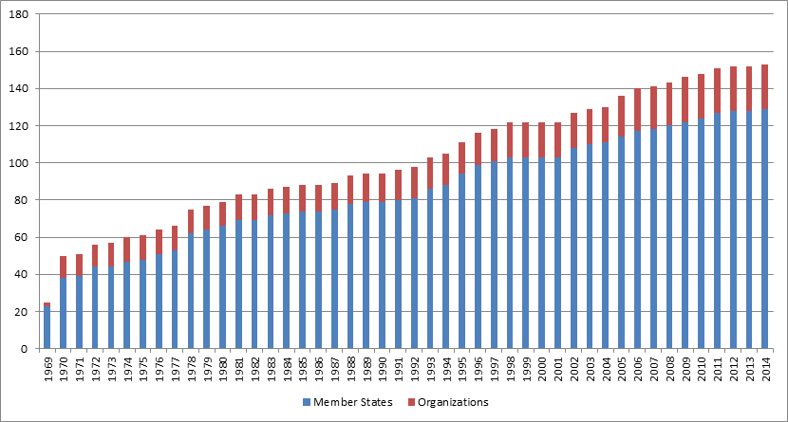
International Nuclear Information System (INIS)
  INIS Membership
Current INIS Members: 153
  (129 countries and 24 international organizations; Afghanistan joined INIS in 2014)
IAEA Members: 162 (as of February 2014)
The 3rd Annual Nuclear Information Technology China Forum, 9 – 10 April 2015, Shanghai, China 5

Slide 6
International Nuclear Information System (INIS)
  The Role of INIS
    Information collection
      collect and process bibliographic metadata and full texts of nuclear literature published in IAEA Member States
    Information preservation
      electronically preserve non-conventional or 'grey' literature, such as IAEA documents, policy & technical reports, other full-text publications from Member States & international organizations
    Information sharing
      make the INIS Collection freely accessible to all Internet users around the world
    Nuclear knowledge organization
      create Thesaurus as a major tool for describing nuclear information and knowledge in a structured form
    Capacity building
      take actions that improve effectiveness of INIS Members in nuclear information management
The 3rd Annual Nuclear Information Technology China Forum, 9 – 10 April 2015, Shanghai, China 6

Slide 7
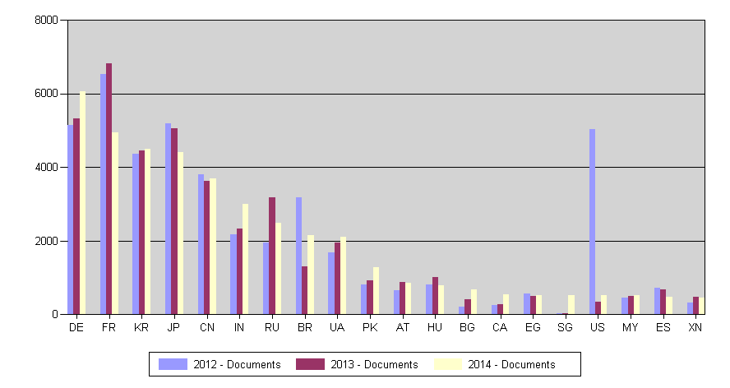
International Nuclear Information System (INIS)
  INIS Collection
    31 December 2014
      3,738,276 bibliographic records
      493,003 full-text documents (NCL) (13.2%)
      1,058,192 NCL (28.3%)
    Annual input ≈115,000 records
Input by Country
Top 20 Contributors (January-September 2014)
The 3rd Annual Nuclear Information Technology China Forum, 9 – 10 April 2015, Shanghai, China 7

Slide 8
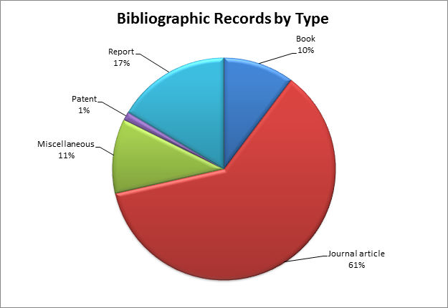
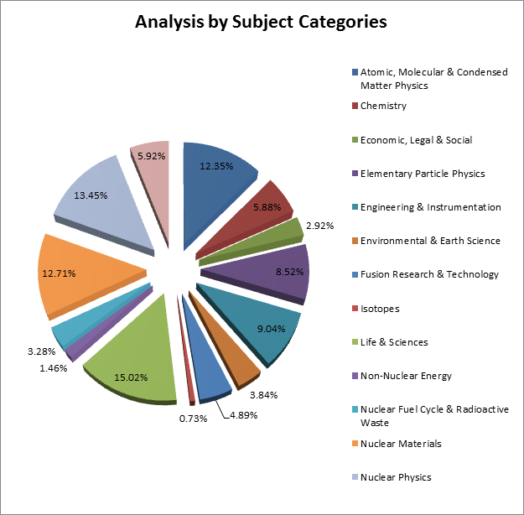
International Nuclear Information System (INIS)
Bibliographic records by literature type
INIS Collection
Bibliographic records by subject category
Conventional literature 71%
  Journal articles 61%
  Books 10%
Non-conventional Literature 29%
  Reports 17%
  Miscellaneous 11%
  Patents 1%
The 3rd Annual Nuclear Information Technology China Forum, 9 – 10 April 2015, Shanghai, China 8

Slide 9
International Nuclear Information System (INIS)
  INIS information preservation
  Digitization efforts
    Digital preservation in Member States
    Microfiche digitization project
    Old IAEA publications
    Total number of full-text (PDF) 493,003
    NCL available from INIS 744,475
    NCL available from other sources 313,717
    Total number of NCL 1,058,192
    28.3% of records are full-text!
The 3rd Annual Nuclear Information Technology China Forum, 9 – 10 April 2015, Shanghai, China 9

Slide 10
International Nuclear Information System (INIS)
  Information sharing
  Access to INIS by Member States (1 January – 31 December 2014)
# | Country | Sessions | New sessions | New users | Bounce rate | Pages/ session
1 | United States | 282,046 (16.18%) | 75.56% | 213,117 | 62.33% | 1.78
2 | India | 135,304(7.76%) | 73.35% | 99,240 | 65.35% | 1.76
3 | Brazil | 80452 (4.61%) | 74.58% | 60000 | 57.03% | 2.16
4 | Japan | 77297 (4.43%) | 62.09% | 47990 | 53.21% | 2.29
5 | United Kingdom | 76067 (4.36%) | 73.10% | 55604 | 59.96% | 1.83
6 | South Korea | 70944 (4.07%) | 64.35% | 45652 | 51.91% | 2.06
7 | France | 69694 (4.00%) | 69.69% | 48568 | 57.18% | 2.23
8 | Germany | 69560 (3.99%) | 73.02% | 50791 | 58.88% | 1.81
9 | Russia | 59286 (3.40%) | 64.97% | 38518 | 62.34% | 2.13
10 | Canada | 49482 (2.84%) | 71.98% | 35617 | 58.86% | 1.94
11 | Indonesia | 39231 (2.25%) | 81.34% | 31912 | 72.52% | 1.51
12 | Iran | 35927 (2.06%) | 64.76% | 23266 | 61.94% | 1.87
13 | Italy | 33456 (1.92%) | 73.72% | 24665 | 58.09% | 1.88
14 | Spain | 28243 (1.62%) | 74.17% | 20947 | 58.52% | 1.91
15 | Turkey | 27025 (1.55%) | 77.11% | 20840 | 62.83% | 1.78
16 | Poland | 26249 (1.51%) | 76.41% | 20056 | 63.83% | 1.76
17 | Australia | 26070 (1.50%) | 78.54% | 20475 | 65.44% | 1.62
18 | Egypt | 25444 (1.46%) | 56.24% | 14310 | 58.54% | 2.16
19 | Mexico | 21170 (1.21%) | 77.53% | 16414 | 60.10% | 1.91
20 | Malaysia | 20274 (1.16%) | 76.04% | 15417 | 66.85% | 1.69
The 3rd Annual Nuclear Information Technology China Forum, 9 – 10 April 2015, Shanghai, China 10

Slide 11
International Nuclear Information System (INIS)
  INIS information sharing
  1970 INIS - the first nuclear database at the IAEA
  1979 INIS - the first IAEA database with online access
  1991 INIS & AGRIS - the first IAEA databases on CD-ROM
  1996 INIS Web Site - the first Web Site at the IAEA
  1998 INIS - the first IAEA database available on the Internet
  2009 All Internet users given free and open access to INIS database
  2009 INIS database becomes accessible via WorldWideScience.org
  2010 INIS offers first Collection Search widget
  2011 INIS launches new web search interface using Google-based technology
  2012 INIS multilingual Thesaurus integrated with the INIS Collection Search
  2012 INIS Collection Search includes the IAEA Library catalogue
  2013 Browse INIS Collection by Subject Category
  2014 INIS Collection becomes searchable through Google and Google Scholar
The 3rd Annual Nuclear Information Technology China Forum, 9 – 10 April 2015, Shanghai, China 11

Slide 12
International Nuclear Information System (INIS)
  ICS statistics 2013 vs. 2014
Visitors
Visits
1,267,304
1,743,518
89,863
147,266
Pageviews
Documents
3,440,760
695,681
682,729
63,719
Bounce rate
Pages/Visit
61.13%
1.97
52.2 %
4.65
PDF downloads: 422,988 vs 58,354
Increase: 724.86%
The 3rd Annual Nuclear Information Technology China Forum, 9 – 10 April 2015, Shanghai, China 12

Slide 13
International Nuclear Information System (INIS)
  Nuclear Knowledge Organization
  INIS Thesaurus is a major tool for describing nuclear information and knowledge in a structured form
  Available in Arabic, Chinese, English, French, German, Japanese, Russian, and Spanish
  December 2014 issue contains 30 855 descriptors, of which 22 148 are valid descriptors and 8707 are forbidden terms
  The terminology used has its origin in the 1969 edition of the EURATOM Thesaurus
  PDF versions:
    Monolingual versions of the thesaurus including the full thesaurus hierarchy
    Multilingual dictionaries without thesaurus hierarchy
    Interactive multilingual thesaurus with navigation capabilities
  Interactive Multilingual INIS Thesaurus with navigation capabilities
  The Thesaurus contains the controlled terminology for indexing information within the subject scope of the INIS and it is intended for use in subject descriptions for input and for multilingual and semantic search
The 3rd Annual Nuclear Information Technology China Forum, 9 – 10 April 2015, Shanghai, China 13

Slide 14
International Nuclear Information System (INIS)
  Capacity building
  INIS training seminars
  eLearning
  Technical cooperation assistance
    Regional training, fellowships, scientific visits
    IT equipment
  Reference manuals
The 3rd Annual Nuclear Information Technology China Forum, 9 – 10 April 2015, Shanghai, China 14

Slide 15
INIS road ahead
  Current social trends
  Population
    Aging population; longer working lives; remote/non-personal interaction; social differences; radicalism/extremism; privacy & surveillance
  Employment
    Uncertainty; change of professions/jobs; increased complexity; informal employment; new collaborative technologies; work from anywhere (connecting to work); Bring Your Own Device (BYOD); millennials as the majority workforce; talent management; work-force motivation
  Education
    Life-long education; e-training; m-education; Massive Open Online Courses (MOOCS); training on demand; high computer literacy
  Health & happiness
    Healthy living; well-being; bio/organic movement; family-work balance; personal/home entertainment
  Community
    Transport; communication; environment; housing; crime; culture & leisure
The 3rd Annual Nuclear Information Technology China Forum, 9 – 10 April 2015, Shanghai, China 15

Slide 16
INIS road ahead
  Current technological trends
Gartner | Forbes | Forrester | Deloitte | Accenture
1 Mobile Device Diversity and Management 2 Mobile Apps and Applications 3 The Internet of Everything 4 Hybrid Cloud and IT as Service Broker 5 Cloud/Client Architecture 6 The Era of Personal Cloud 7 Software Defined Anything 8 Web-Scale IT 9 Smart machines 10 3-D printing | 1 Consumers will come to expect Smart TV capabilities 2 Smart watches will become ‘smarter’ 3 Google Glass will still be in “wait and see” mode 4 Other applications and uses for Apple’s TouchID will emerge 5 Xbox One and PS4 will blur the lines between entertainment and video gaming 6 3D printing will begin to revolutionize production 7 The movement toward natural language search will make searching more accurate and intuitive | 1 Digital Convergence Erodes Boundaries 2 Digital Experience Delivery Makes (or Breaks) Firms 3 APIs Become Digital Glue 4 The Business Takes Ownership Of Process And Intelligence 5 Firms Shed Yesterday's Data Limitations 6 Sensors And Devices Draw Ecosystems Together 7 'Trust' And 'Identity' Get A Rethink 8 Infrastructure Takes On Engagement 9 Firms Learn from the Cloud and Mobile 10 IT Becomes an Agile Service Broker | Disruptors 1 CIO as venture capitalist 2 Cognitive analytics 3 Industrialized crowdsourcing 4 Digital engagement Wearables Enablers 1 Technical debt reversal 2 Social activation 3 Cloud orchestration 4 In-memory revolution 5 Real-time development operations | 1 Big is the next big thing 2 Digital-physical blur 3 From workforce to crowd-source 4 Data supply chain 5 Harnessing hyperscale 6 The business of applications 7 Architecting resilience
The 3rd Annual Nuclear Information Technology China Forum, 9 – 10 April 2015, Shanghai, China 16

Slide 17
INIS road ahead
  INIS relevant trends
Improve digital presence
Increase use of mobile devices and apps
Cloud computing
Open access and cooperation
Use social media
Follow new technologies
Encourage creativity and innovation
Concentrate on training and education
Tomorrow belongs to the people who prepare for it today!
African proverb
The 3rd Annual Nuclear Information Technology China Forum, 9 – 10 April 2015, Shanghai, China 17

Slide 18
INIS road ahead
Information/literature evaluation
  Strengthen the role and position of national INIS centres; Improve tools & methodologies
Information acquisition
  Alternative ways (direct DB access, harvesting); Alternative forms (data, video); Open sources ; Increase number of NCL; Finalize digitization of INIS microfiche collection
Processing
  Simplified bibliographic metadata set; Introduce FIBREonline; Separate metadata creation and subject analysis; Introduce automatic indexing
Organization and repackaging
  Leverage technology; Streamline systems; Offer new info-services
Storage, protection and preservation
  Streamline IT systems and applications; Use cloud computing; Emphasize preservation aspect ; PDF/A long-term archival format
Maintenance and updating
  Follow new IT technologies; Change; Innovate
Sharing
  Cooperate with publically open discovery & other systems; INIS as open access repository; Go mobile; Federated search; Social networking, bookmarking, tagging; Social media ; Offer better reference service
The 3rd Annual Nuclear Information Technology China Forum, 9 – 10 April 2015, Shanghai, China 18

Slide 19
They must often change who would be constant in happiness or wisdom!
Confucius (2550 years ago)
Thank you!
The 3rd Annual Nuclear Information Technology China Forum, 9 – 10 April 2015, Shanghai, China 19

