Slide 1
17th International Conference on Grey Literature
A New Wave of Textual and Non-Textual Grey Literature
1-2 December 2015, Amsterdam
Public Interest in Accessing the INIS Collection
Dr Dobrica Savić
d.savic@iaea.org
Nuclear Information Section
IAEA, Vienna

Slide 2

Presentation
Public Interest in Accessing the INIS Collection
✗
Who
&
Why?
Subject coverage
Type of documents
Uniqueness
✓
Use analytics to confirm this and to
challenge and improve services!

Slide 3
Presentation at a glance
International Atomic Energy Agency (IAEA)
IAEA nuclear information goals
International Nuclear Information System (INIS)
INIS repository
INIS collection by subject
INIS collection by record types
Collection uniqueness
Access analytics
Conclusions

Slide 4
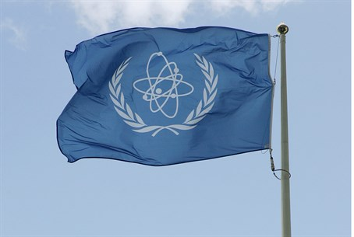

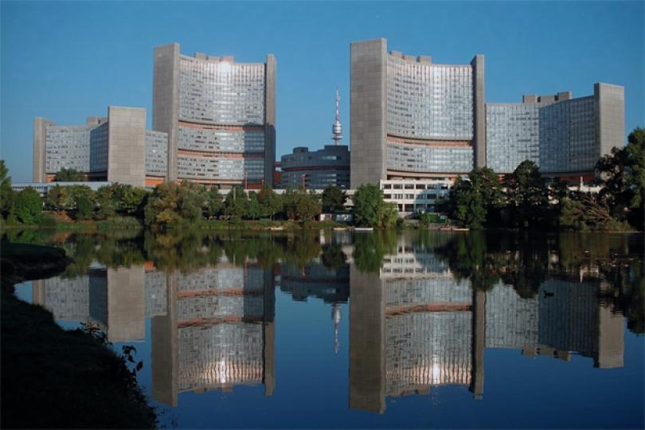
International Atomic Energy Agency (IAEA)
1957
165
2300
100
Promote safe, secure and peaceful uses of nuclear technologies

Slide 5
IAEA nuclear information goals
    Foster the exchange
    of STI on the peaceful use of nuclear science and technology
    (collect, process, preserve, disseminate)
    Increase awareness
    of the importance of managing nuclear information resources
    Assist with capacity building and training
    Provide information services and support to Member States

Slide 6
International Nuclear Information System (INIS)
NCL in the field of nuclear science and technology
IAEA 1970
130 states and 24 international organizations
The role:
  To collect and process
  metadata & full-texts of nuclear literature
  To preserve
  NCL (documents, reports, & other full-text publications)
  To disseminate
  publications from the INIS repository free of charge to all
  Internet users
Free, open and unrestricted web access since April 2009
iaea.org/inis

Slide 7
INIS repository
Status on 1 October 2015:
  3,846,526 bibliographic records
  1,020,000 full-text documents
  (750,000 INIS & 320,00 other sources)
Average annual input over 115,000 records
Visits to iaea.org/inis (2015)
  Over 1 million sessions
  Over 2 million pageviews
  2 pages per session
  61% bounce rate (single page visits)
  30% returning visitors
  US, India, UK, Germany, Japan, France, South Korea, Canada, Brazil
Downloads
  2014: 423,000
  2015: 100,000 ICS + 1.5 million through Google
  Search terms
    Nuclear reactors; radioactive waste; environment; Fukushima; accidents

Slide 8
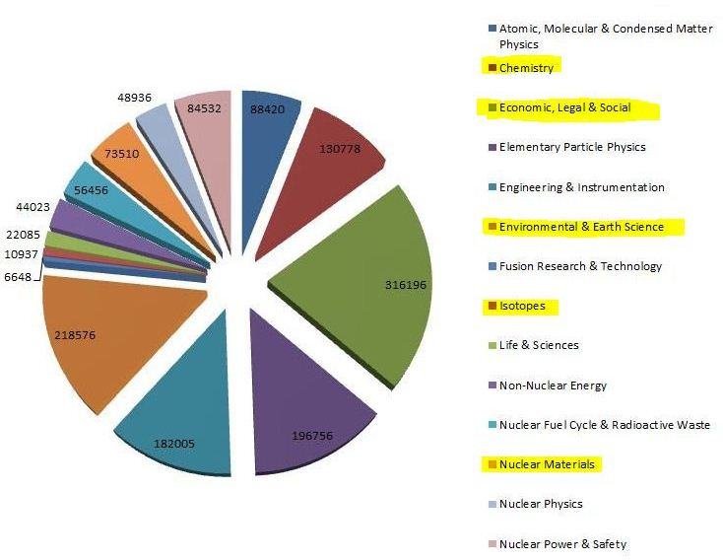
INIS collection by subject
6
5
1
3
4
2
8
1 October 2015: 3,846,526 records
7
49 subject categories grouped into 14 subject areas

Slide 9
INIS collection by record type
- Audio-visual
- Computer media
1 October 2015: 3,846,526 records
73% vs 27%

Slide 10
Collection uniqueness
Not indexed by commercial database providers
(Web of Science, EBSCO, Science Direct, ProQuest, etc.)
80 % of the collection is not in Google
Google.com search for terms:
  Radiology (62*) (20%, only 1 extra link)
  Reactor safety (S21*) (10%, only 1 extra link)
  Radiation protection (61*) (10%, only 1 extra link)
    allintitle: “xxx"
  filetype:pdf
  -site:iaea.org
  -site:worldwidescience.org
  -site:google.com
  ICS exact phrase + full-text
  *S61 & S62 Life sciences
  *S21 Nuclear power and safety

Slide 11
Access analytics
Status on 1 October 2015:
- 3,846,526 bibliographic records
- 1,020,000 full-text documents (750,000 INIS & 320,000 other sources)
Average annual input 120,000+
Sessions: 1 million
Page views: 1. 9 million
Users: 726,000 (30% new visitors)
Bounce rate (single page entry): 61%
Downloads through ICS 100,000
Downloads through Google.com 1.5 million
Total downloads 1.6 million
Most downloaded documents:
  Radiology & nuclear medicine
  Reactor safety
  Radiation protection

Slide 12
Access analytics (cont.)
INIS Collection access statistics by document type
 | # of records (3,856,529) | % of the collection | # of records accessed | % of records accessed | # of accesses (1,296,607) | % of all accesses
Journal article | 2,386,933 | 61.89% | 108,074 | 4.53% | 500,342 | 38.58%
Report | 618,619 | 16.04% | 60,260 | 9.74% | 266,194 | 20.53%
Misc.* | 406,386 | 10.54% | 44,159 | 10.87% | 211,731 | 16.33%
Book | 390,067 | 10.11% | 35,944 | 9.22% | 304,192 | 23.46%
Patent | 46,429 | 1.20% | 2,212 | 4.76% | 7,546 | 0.58%
Multimedia | 7,829 | 0.20% | 1,284 | 16.40% | 6,498 | 0.50%
Obsolete types** | 266 | 0.00% | 19 | 7.14% | 104 | 0.00%
27.44%
27.78%
* Miscellaneous: theses, pamphlets, brochures, conference proceedings
** Obsolete: G:Maps; F: Audio-visual materials; C: Conference

Slide 13
Conclusions
    Open access collections/DB bring huge number of users
    Specific subject related coverage attracts special user groups (edu, gov)
    Most frequently downloaded documents are NOT from the most populous parts of the collection
    80% of the INIS Collection is unique
    If NCL available from other sites, it is usually only the originator’s website
    Access to NCL is directly proportional to their representation in the collection
    Users are looking for information irrelevant of its form

Slide 14
True life is lived when tiny changes occur!
Leo Tolstoy
Thank you!

