Slide 1
United Nations Library and Information Network for Knowledge Sharing
UN-LINKS, 28 – 30 September 2016, Paris
Impact of Current Technology Trends
on Information Management
Dr. Dobrica Savić
d.savic@iaea.org
Nuclear Information Section
IAEA, Vienna

Slide 2

Presentation at a glance
Information technology progress
Present state of information management
The future of information management
Current information technology trends
Aggregated trends
Impact on information management
Disruptive technologies

Slide 3
Information technology progress
  Tremendous development
  Boundary-pushing innovations
  Constant change
  Fast pace
  Examples
  "Moore's law" the number of transistors in a dense integrated circuit has doubled approximately every 18 months
  The processing power of computers from 1956 to 2015 increased 1 trillion-fold
  1994 first mobile phone to feature software applications (IBM Simon); 2007 iPhone (first commercial smartphone to use finger input); 2010 the Samsung Galaxy S
  1975-2008 one billion PCs sold; in 2013 alone 1 billion cell phones sold
  89% of China’s 668 million Internet users access the web from their mobile devices. Similar with other developing nations
  In January 2014, mobile phone Internet usage overtook PC Internet usage
  In January 2016, Google’s AlphaGo crossed a major artificial intelligence threshold by besting human grandmaster Lee Sedol at the famously complex game of Go

Slide 4
Present state of information management
Libraries and information centers disappearing
Staff count and professional work decreasing; Evident skill gaps
Budgets for library and information centers dropping
External content price increasing, access to it more difficult
High cost of new systems and applications
Intellectual property management challenges
External competition (e.g. Amazon, Google)
Increased user demands (e.g. delivery speed, format, added value)
Notion that everything is already on the web
Libraries becoming more local in their focus

Slide 5

The future of information management?
Current trends that impact the future
Disruptive innovation

Slide 6
Current information technology trends – 2016
Gartner | Forbes | Forrester | Deloitte | Accenture
1. The device mesh 2. Ambient user experience 3. 3D printing materials 4. Information of everything 5. Advanced machine learning 6. Autonomous agents and things 7. Adaptive security architecture 8. Advanced system architecture 9. Mesh App and service architecture 10. Internet of things architecture and platforms Gartner's top 10 strategic technology trends for 2016 | 1. Connecting customers 2. Embracing millennials 3. Remote employee development and training 4. Strength based leadership 5. Add extra value to commodity products you sell 6. Corporate culture of customer service 7. Deliver results, not just solutions 8. Engage customers through fun and games 9. Integrate impartial content to support customer decisions 10. Develop “selling/solving” skills for non-salespeople Top 10 Business Trends That Will Drive Success In 2016 | 1. Smart connected world 2. Systems of insight 3. APIs as strategy 4. Digital CX limitations 5. Security and risk rethink 6. Hyper-connected hyper-adopters 7. Business tech acceleration 8. Infrastructure snowballs 9. Software as part of the brand 10. Workforce technology The Top Technology Trends To Watch: 2016 To 2018 1. From customer-aware to customer-led 2. From data-rich to insight-driven 3. From perfect to fast 4. From silos to connected The Operating Model for Customer Obsession | 1. Right-speed IT 2. Augmented & virtual reality go to work 3. Internet of Things: From sensing to doing 4. Reimagining core systems 5. Autonomic platforms 6. Blockchain: Democratized trust 7. Industrialized analytics 8. Social impact of exponential technologies Tech Trends 2016: Innovating in the digital era 1. Organizational design 2. Leadership 3. Culture 4. Engagement 5. Learning 6. Design thinking 7. Changing skills of the HR organization 8. People analytics 9. Digital HR 10. Workforce management Global Human Capital Trends 2016 | 1. Intelligent automation 2. Liquid workforce 3. Platform economy 4. Predictable disruption 5. Digital trust Technology Vision 2016 - People First: The primacy of people in a digital age

Slide 7
Aggregated trends
Technology
Secure architecture
Autonomous agents
Machine learning (algorithms)
Internet of things (from sensing to doing)
Application Program Interface (API)
3D printing
Products/services
Added value
Deliver results, not just solutions
Social impact
Predictable disruption
Digital trust
Analytics
Customers
Customer culture
Connected world
User experience
Engage customers
From data-rich to insight-driven
Employees
New generation
Liquid workforce
Remote work
Learning & training
New skills (leadership, sales)
From silos to connected

Slide 8
Information management – Technology impact
Secure architecture
Autonomous agents
Machine learning (algorithms)
Internet of things (from sensing to doing)
Application Program Interface (API)
3D printing
More difficult access to information resources (IR)
Higher level of IT investment required to access and process IR
More tech-driven and dynamic documents and IR
Increased amount of big data

Slide 9
Information management – Products and services impact
Added value
Deliver results, not just solutions
Social impact
Predictable disruption
Digital trust
Analytics
Available resources
Competition with ‘big players’
Lack of interest to use classic channels
Increasing role of local repositories
Intellectual property protection
Disappearing e-archives and older materials

Slide 10
Information management – Customer impact
Customer culture
Connected world
User experience
Engage customers
From data-rich to insight-driven
High expectations and demands (comprehensiveness, relevance, aggregation, added value)
Interconnectivity
Top of the line finding tools
Web 2.0 features (social networking, collaboration, user generated content)
Tools to exploit big data
Mobile addiction of the new generation
Lack of patience and understanding

Slide 11
Information management – Employee impact
Lack of proper education
Career development possibilities
Frequent change of jobs and interests (lack of continuity and long-term planning)
Changing technical requirements
Business focus
Missing culture of preservation
Multitasking and rapid delivery
New generation
Liquid workforce
Remote work
Learning & training
New skills (leadership, sales)
From silos to connected

Slide 12
Disruptive technology
  Iteration
  Doing the same things better (business as usual)
  Innovation
  Doing new things (compete for the moment)
  Disruption
  Doing new things that make the old ones obsolete
  (compete for the future)

Slide 13
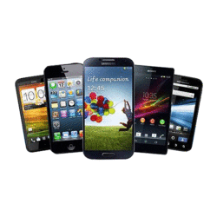
Disruptive technology #1
  Mobile devices
  1975-2008 one billion PCs sold; in 2013 alone 1 billion cell phones sold
  89% of China’s 668 million Internet users access the web from their mobile devices.
  72% of children in South Korea own a smartphone by the age of 11 or 12
  In January 2014, mobile phone Internet usage overtook PC Internet usage
  Mobile-first and mobile-only world repurpose the web to become more dynamic, personal and useful
  The end of a traditional information-broadcast, page/form-based, keyword system

Slide 14
Disruptive technology #2
  Chatbots
(A computer program designed to simulate conversation with human users over the Internet)
Virtual assistants offering predictive services with the help of machine learning and A.I.
Two types: one functions based on a set of rules and the other one uses machine learning
Subject areas: Weather, grocery, news, life advice, personal finance, scheduling, a bot that’s your friend
Examples: Microsoft Cortana, Google Now, Amazon Alexa, Apple Siri, Facebook Jarvis
Alex, the Staffordshire University Library chatbot service; Dewey; Pixel
Reference interviews

Slide 15
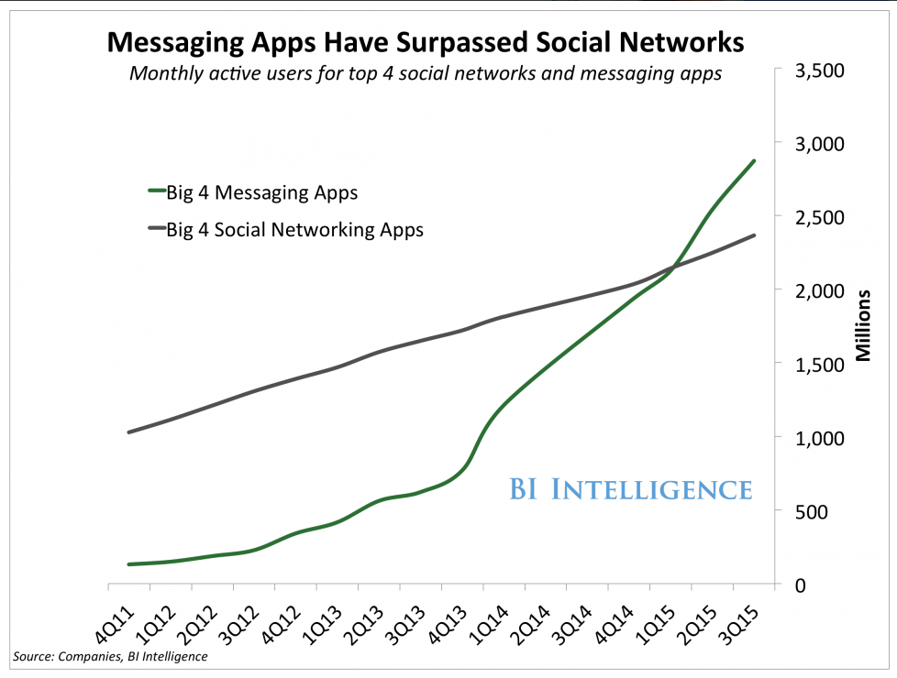
Disruptive technology #3
  Messaging apps
WhatsApp, Facebook Messenger, WeChat, and Viber have 2.125 billion monthly
active users globally (users who accessed the apps at least once in a 30-day period).
And these are all mobile users.
Numbers for Facebook, Twitter, LinkedIn, and Instagram also include millions of
computer-only users!

Slide 16
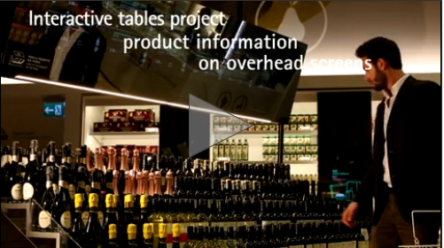
Disruptive technology #4
Smart supermarkets – COOP Milano, Italia
Smart shelves and interactive food display tables offer a range of product information, such as provenance, allergens, nutritional data and carbon footprint.
Shoppers have the tools and information to make their experience convenient, relevant and personalized.
Digital displays share real-time information on promotions, best-sellers and more.
A mobile app helps customers navigate the store, augments product information, and identifies products that are compatible with their lifestyle needs.
The supermarket and suppliers also benefit from greater efficiency and customer interaction.
Staff can speak with the warehouse in real time to rapidly procure new assortments and replenish shelves.

Slide 17
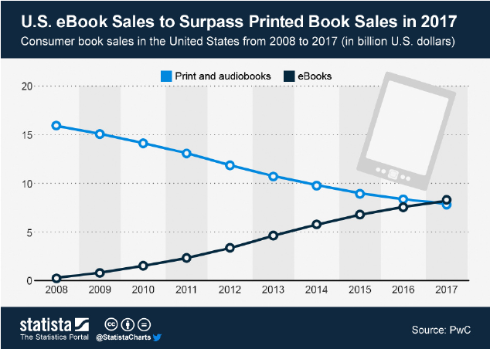
Disruptive technology #5
Books
140M total number of books
70M grey literature
2.2M new book titles annually
The average U.S. nonfiction book sells less than 250 copies per year and less than 3,000 copies over its lifetime
A book has less than a 1% chance of being stocked in an average bookstore
  eBooks
Amazon.com
In 2014 Amazon sold more than 60% of all books purchased online
In July 2010, Amazon's Kindle e-book sales outpaced hardcover book sales
Audible 2008
Goodreads 2013 (social network for book-lovers)

Slide 18
Disruptive technology #6
  Web
1B websites (host names); 70% not active (parked)
50B webpages
4.75B pages indexed by Google
3.6B Internet users (world population 7.5B)
1 second on the Web
7000 Tweets sent
1140 Tumblr posts
733 photos posted on Instagram
2207 Skype calls
55,364 Google searches
127, 354 YouTube videos viewed
2 million emails sent
http://www.internetlivestats.com/
To download the Web using a PC
would take approximately
11 trillion years!

Slide 19
Disrupt or be disrupted!
Thank you!

