Slide 1
Faster, smarter and richer. Reshaping the library catalogue (FSR 2014)
Rome, 27-28 February 2014
USING GOOGLE SEARCH APPLIANCE (GSA)
TO SEARCH DIGITAL LIBRARY COLLECTIONS
A Case Study of the INIS Collection Search (ICS)
Dobrica Savić
d.savic@iaea.org
Nuclear Information Section
IAEA, Vienna

Slide 2
Presentation at a glance
Challenge and Solution in a Nutshell
IAEA & NIS
International Nuclear Information System (INIS)
INIS Collection
Search Engine
ICS Screenshots (Simple, Advanced, Metadata Search)
Main Features of the INIS Collection Search
GSA Advantages and Disadvantages

Slide 3
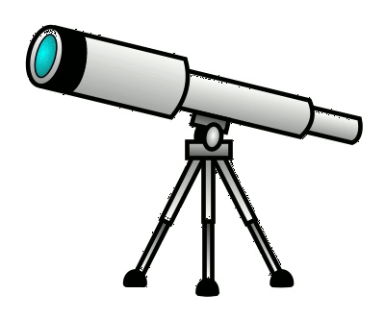
Challenge and Solution in a Nutshell
Challenge
  How to revamp the on-line database catalogue with 3.6 million bibliographic records and full-text nuclear documents, and increase its use, accessibility, usability, and expandability?
Solution
Make it open and freely accessible to the public
Replace a legacy database search with a Google-based one
Simplify the basic search interface and improve the advanced search
Incorporate rich features but make them as discrete as possible
Incorporate with Google.com and Google Scholar
inis.iaea.org/search

Slide 4
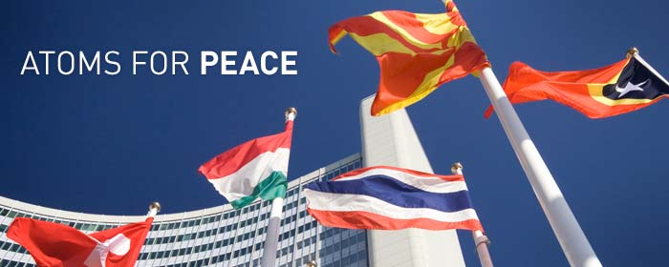

IAEA and Nuclear Information Section
International Atomic Energy Agency (IAEA)
  The world's leading Agency for cooperation in the nuclear field
  Created in 1957 as part of the United Nations family
  The IAEA works with its 159 Member States and multiple
  partners worldwide to promote safe, secure and
  peaceful uses of nuclear technologies
  The IAEA Secretariat is based in Vienna, Austria, with 2300
  multi-disciplinary professional and support staff from more than 100 countries
Nuclear Information Section (NIS)
  Consists of the International Nuclear Information System (INIS), the IAEA Library,
  and the System Development and Support Group (SDSG)
  The objectives are to:
    foster the exchange of scientific and technical information on the peaceful use of nuclear science and technology (collect, process, preserve and disseminate)
    increase awareness in Member States of the importance of maintaining efficient and effective systems for managing nuclear information resources
    assist with capacity building and training
    provide information services and support to Member States & the IAEA

Slide 5
International Nuclear Information System (INIS)
INIS is one of the world's largest custodians of non-conventional published literature in the field of nuclear science and technology
  Established as part of the IAEA in 1970. INIS operates under special membership arrangements that set specific duties and privileges
  128 countries and 24 international organizations are INIS Members
  The role:
    to collect and process bibliographic metadata and full-texts of nuclear literature published in IAEA Member States
    to electronically preserve non-conventional or 'grey' literature, such as IAEA documents, policy reports and other full-text publications from Member States
    to make the INIS Collection of publications freely accessible to all Internet users around the world
Free, open and unrestricted web access to the INIS Collection since April 2009

Slide 6
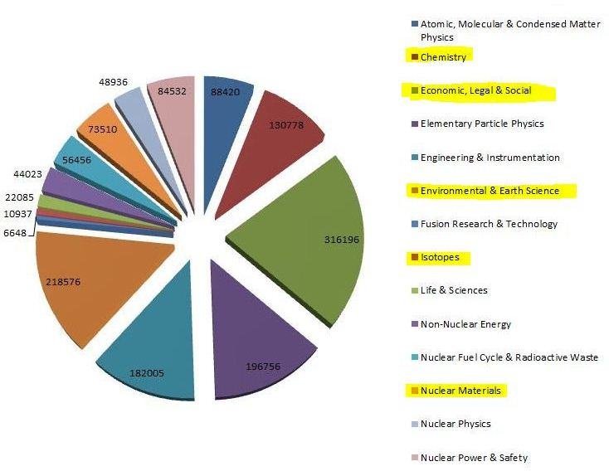
INIS Collection
120,000+ annual input
1 January 2014: - 3,623,201 bibliographic records
- 482,951 full-text documents (NCL) (13.4%)
INIS Collection by Subject

Slide 7
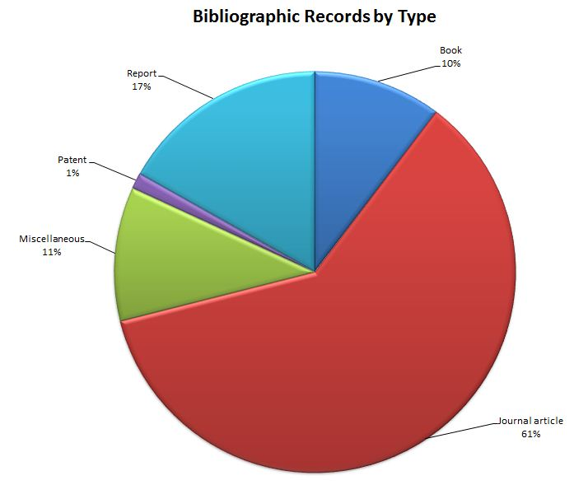
INIS Collection (cont.)
1 January 2014: 3,623,201 records

Slide 8
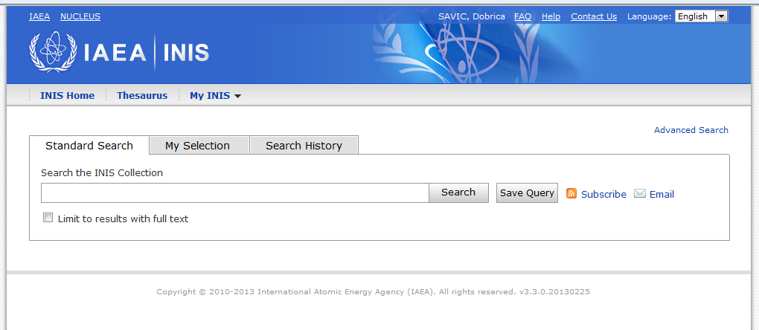
Search Engine
Old Search 1970-2011
BASIS RDBMS
Ownership and support (OpenText)
Speed
Cluttered interface made for librarians
Only advanced search
Full-text indexing not implemented
Multilingual interface/search support
Support for use of thesaurus and authorities
New Search 2011
Google Search Appliance (GSA)
Tremendous speed and scalability
Uncluttered, easy to use start-up interface
Advanced options to broaden or tighten search
Full-text indexing
More relevant results
Faceted/filtered search
inis.iaea.org/search

Slide 9
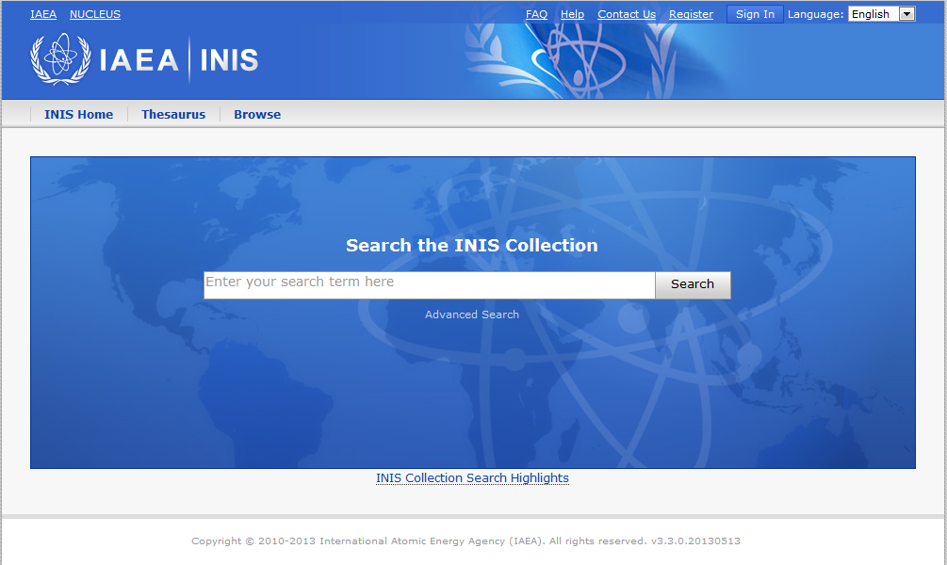
ISC: Simple Search
FSR 2014, 27-28 February 2014
Notes:
Main Search box
Area for general/main links
Link to Advanced Search
Link to highlights – or history of ICS
Language selector

Slide 10
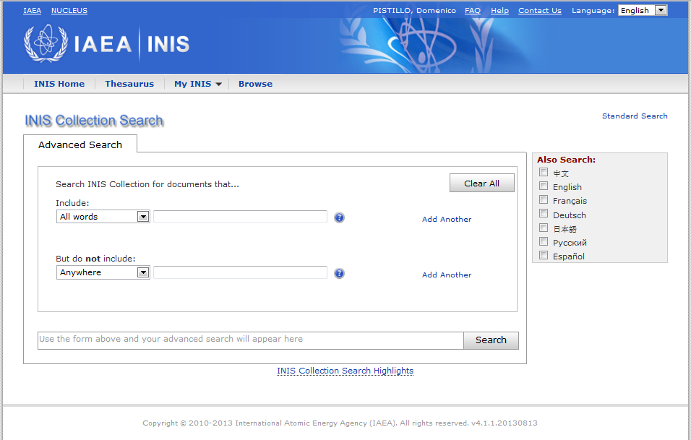
ISC: Advanced Search
FSR 2014, 27-28 February 2014
Notes:
If we go to advanced search, you can see an area to add search criteria, an area to add critera not to be included and the opportunity to search translated terms in various languages.

Slide 11
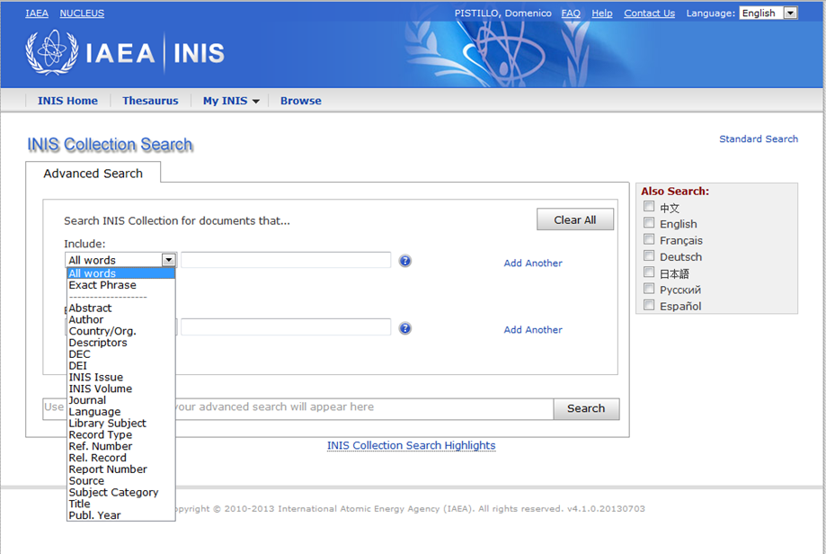
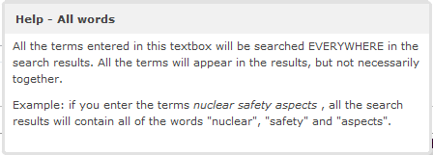
ISC: Metadata Search
FSR 2014, 27-28 February 2014
Notes:
If we choose the dropdown you can see the list of fields one can search in.

Slide 12



Main Features of the INIS Collection Search
  Platform
    Google Search Appliance© technology - renowned, simple, fast, flexible
    Project started in 2010. Current version 4.3, January 2014
    Virtual servers within the IAEA
    24/7 availability
  Accessibility
    Free and open web-base application. Nothing to install
    Mobile Apps for iPAD, iPHONE, Android
    Widget for searches from other websites with or without filter
  Ease of use
    Intuitive, self-explanatory initial screen
    No previous INIS Collection knowledge required
    A single search box communicates confidence to users that our search tools can meet their information needs from a single point of entry
  Advanced Search
    Offers more precise search
    Metadata and Boolean search
    Query builder with syntax generator
    Search for all words & exact phrase; include/exclude metadata; select languages; range queries (2007..2009) ; dropdown menus

Slide 13


Main Features (cont.)
  Faceted search
    Dynamic navigation through country, language, publication year, INIS Volume
  Expandability
    To new collections, databases, repositories
    To new formats/type of documents
  Multilingualism
    ICS interface available in 8 languages
    INIS/ETDE Thesaurus also available in 8 languages (cross-language search)
  Authority Files
    Journal titles; CODEN; ISSN; Subject category; Descriptor; Country/Organization; Author; Report number

Slide 14
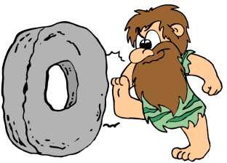


Main Features (cont.)
  Usability
    Print/export results in different formats (PDF, HTML, Excel, XML)
    Download of citations in plain text, RIS format, RefWorks, EndNote
    Creation of RSS feeds
    E-mail search results as a link
    Stop words for languages other than English
    Translation of bibliographic records into other languages using Google Translator
  User profiling
    User registration (Single Sign-On)
    Set up interface language; number of displayed results per page; save queries; search updates; email query results
    Workspace concept (save documents found; translate into other languages)
  Help
    FAQ (on INIS and on ICS)
    On-line help file
    Pop-up hints: examples on how to build a query using metadata
    E-training course

Slide 15



GSA Advantages and Disadvantages
    PROS
      Users’ familiarity with a Google-type interface
      Possibility to include many features in foreground or background
      Scalability
      Quick and relevant response to searches
      Many features available out of the box, with little configuration
      Easy to customize the UI by editing the XSLT
      Impact of opening access to Google.com and Google Scholar
      2013: 50,000 searches and 3,000 downloads a month
      2014: 300,00 searches and 32,000 downloads a month
    CONS
      Cost: license for records, development, daily running and maintenance
      GSA index and/or database is not in administrator’s control, no direct access to it
      GSA is a search tool. It is not a collection management tool, not a reporting tool, and not a statistical tool
      Limitations in building queries: wild card search is not possible
      Branding and long-term indirect impact

Slide 16
Age si quid agis!
If you do something, do it well!
Thank you!

