Slide 1
United Nations Library and Information Network for Knowledge Sharing (UN-LINKS)
18 - 20 September 2013, Geneva
The Future of Libraries
Dobrica Savić
Nuclear Information Section
IAEA, Vienna

Slide 2

Prague

Slide 3

Washington, D.C.

Slide 4
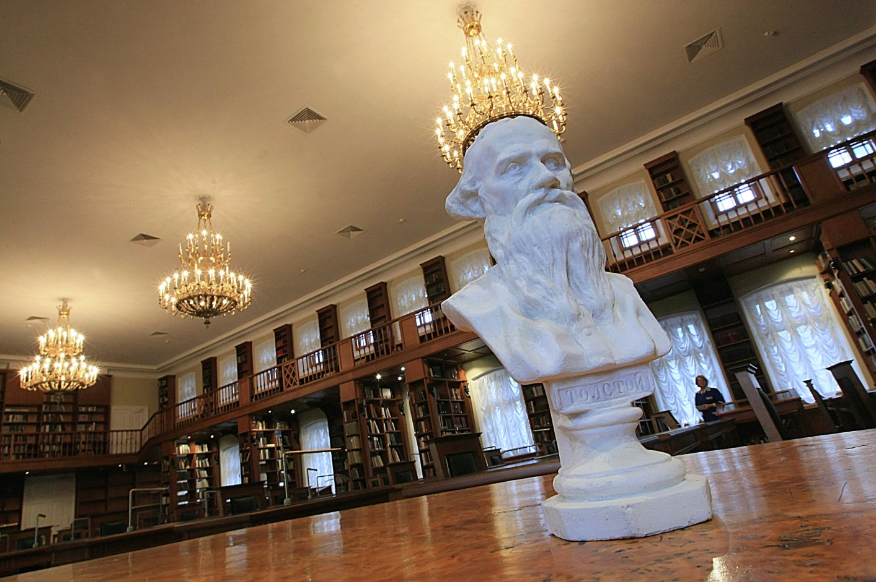
Moscow

Slide 5

Oxford

Slide 6

Vienna

Slide 7

New York

Slide 8

St. Petersburg

Slide 9
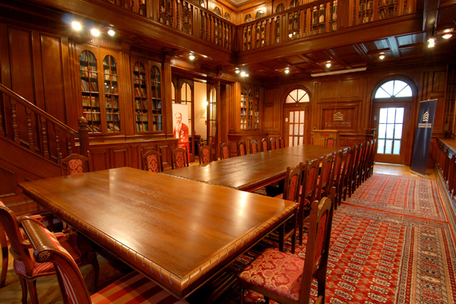
Belgrade

Slide 10

Dublin

Slide 11
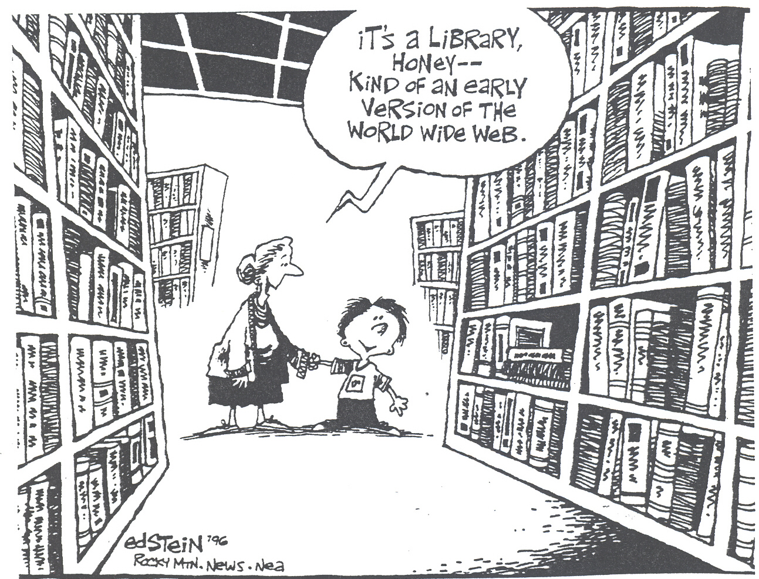

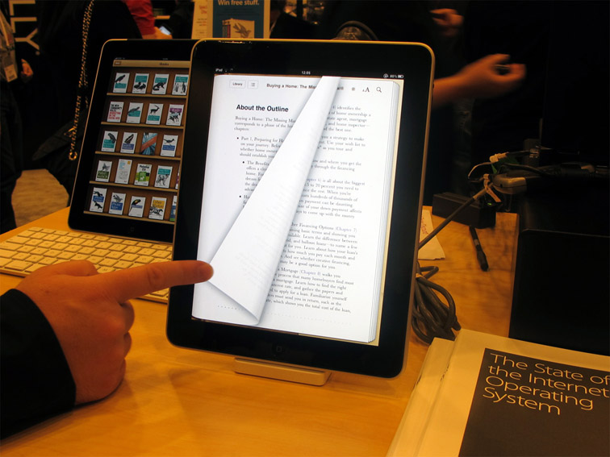
The future of libraries

Slide 12

The future of libraries
Why should we care?
What current trends define the future?
What can we do?

Slide 13

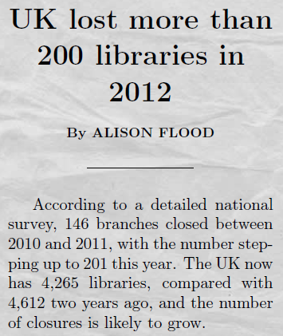

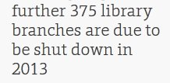
Why should we care?

Slide 14

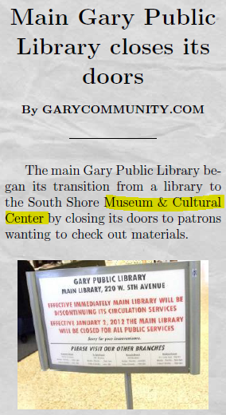

Why should we care?

Slide 15
Why should we care?
CNN
  Library is dying - and it's taking its shushing ladies, dank smell and endless shelves of books with it
The New York Review of Books
  All across the US, large and small cities are closing public libraries or curtailing their hours of operations
Digital Book World
  Librarians: a dying breed? Will librarians go the way of the soda jerk, telephone operator and travel agent?
The Now Newspaper
  Libraries could be going the way of the video rental store; technology training programs offered on site… that's a big part of what libraries do
Skolkovo Moscow School of Management
  On the list of 30 professions that will disappear within the next 5-10 years, librarians are listed first!
Bain & Company (publish a regular report on management tools and trends; 1200+ global CEOs)
  KM (glorified Information Management) dropped from the 10th most popular tool in 2006 to out of top 25 in 2012

Slide 16
Why should we care?
How about the UN libraries?
Diminishing importance
Role ambiguity
Budget cuts
Fewer professional staff members
Space reductions
Library closures (ICAO, UNEP, IFFAD…)

Slide 17
Current trends
PRESENT STATUS TRENDS
Paper collection - Digital content
Collection owners - Information & data intermediary
Legacy library catalogues - Fast & simple search/retrieval Labour intensive systems - Computer centred processing
Free for all information sharing - Revenue generation Physical space & presence - Virtual working place & workforce
Copyrighted materials - Open source
Limited (diminishing) funding - Rising collection/processing costs
Weakening referral role - Google & Wikipedia
Reference services - Relevance, aggregation, curation
Information management - Knowledge management

Slide 18
Current trends
Basic Services (4S-scheme)
Selection - Discovery, acquisition, DRM, relevance
Storage - Offline replaced by online availability
(e.g. OverDrive, NetLibrary, Safari)
Services - Landing and delivery becomes access management;
reference becomes knowledge discovery
Support - Source evaluation and relevance; life-long learning;
e-training

Slide 19
What can we do?
● Digital content
● Subscriptions to DBs and
large publishers/suppliers
● Open access documents
● No ownership
● Internal publications
● No physical space
● Web location
● Virtual / Cloud space
Space
Collection
L
I
B
R
A
R
y
● Access to external & internal information, data, e-publications
● Online access
● DRM management
● Knowledge mediation
● Training ● CIP
● Interactive & integrated
Role
Services
● Remote working
● Temporary employees
● Skilled labour & training
● Outsourcing
● Min number of staff
● Extensive automation
● Simplification
● Fast & standard apps
● Mobile devices
● Social media
Staff
Tools
● Sophisticated users
● Full text & embed, serv.
● Multimedia
● 24/7 comm. & support
Users/Customers

Slide 20

What can we do?
● Digital content
● Subscriptions to DBs and
large publishers/suppliers
● Open access documents
● No ownership
● Internal publications
● No physical space
● Web location
● Virtual / Cloud space
Space
Collection
L
I
B
R
A
R
y
● Access to external & internal information, data, e-publications
● Online access
● DRM management
● Knowledge mediation
● Training ● CIP
● Interactive & integrated
Role
Services
● Remote working
● Temporary employees
● Skilled labour & training
● Outsourcing
● Min number of staff
● Extensive automation
● Simplification
● Fast & standard apps
● Mobile devices
● Social media
Staff
Tools
● Sophisticated users
● Full text & embed, serv.
● Multimedia
● 24/7 comm. & support
Users/Customers

Slide 21
What can we do?
REACTIVE ►
mute
PROACTIVE ►
speak
INTERACTIVE ►
discuss
INTEGRATED ►
create

Slide 22
Knowing is not enough. We must apply.
Willing is not enough. We must do.
Johann Wolfgang von Goethe
Thank you!

