Slide 1
United Nations Library and Information Network for Knowledge Sharing (UN-LINKS)
18 - 20 September 2013, Geneva
Introducing a Google-type Search to a Digital Library
Dobrica Savić
Nuclear Information Section
IAEA, Vienna

Slide 2
Contents
Presentation at a Glance
IAEA and Nuclear Information Section (NIS)
International Nuclear Information System (INIS)
INIS Collection
Introduction of new INIS Collection Search (ICS)
ICS Main Features
GSA Advantages and Disadvantages

Slide 3
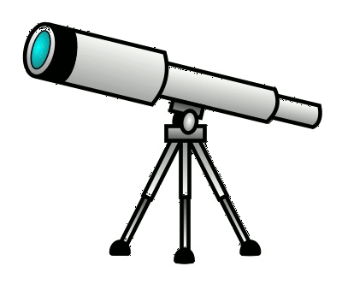
Presentation at a Glance
How to revamp a classical database of 3.5 million bibliographic records and full-text nuclear documents?
Achieve multiple benefits: increase use, accessibility, usability, expandability, interface
Make it open and freely available to the public
Replace a legacy database search with a Google-based one
Simplify the basic search interface. Improve advanced search
Incorporate rich features but make them as discrete as possible
inis.iaea.org/search

Slide 4
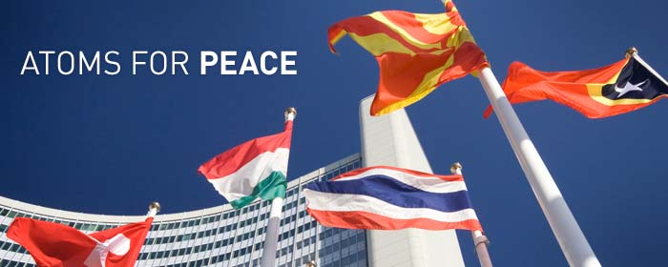

IAEA and Nuclear Information Section
International Atomic Energy Agency (IAEA)
  The world's leading Agency for cooperation in the nuclear
  field
  Set up in 1957 as part of the United Nations family
  The Agency works with its 159 Member States and multiple
  partners worldwide to promote safe, secure and
  peaceful use of nuclear technologies
  The IAEA Secretariat is based in Vienna, Austria, with 2300
  multi-disciplinary professional and support staff from more than 100 countries
Nuclear Information Section (NIS)
  Consists of the International Nuclear Information System (INIS),
  the IAEA Library and the Systems Development and Support Group (SDSG)
  The objectives are:
    to foster the exchange of scientific and technical information on peaceful use of nuclear science and technology (collect, process, preserve and disseminate)
    to increase awareness in Member States of the importance of maintaining efficient and effective systems for managing information resources on the peaceful use of nuclear science and technology
    to assist with capacity building and training
    to provide information services and support to the Member states and to the Agency

Slide 5
International Nuclear Information System (INIS)
INIS one of the world's largest custodians of non-conventional published literature in the field of nuclear science and technology
  Established as part of the IAEA in 1970. INIS operates under special membership arrangements that set specific duties and privileges
  128 countries and 24 international organizations are INIS Members
  The role:
    to collect and process bibliographic metadata and full-texts of nuclear literature published in IAEA Member States
    to electronically preserve non-conventional or 'grey' literature, such as IAEA documents, policy reports and other full-text publications by Member States
    to make INIS collection of publications freely available to all Internet users around the world
Since April 2009 Free, open and unrestricted access to INIS Collection

Slide 6
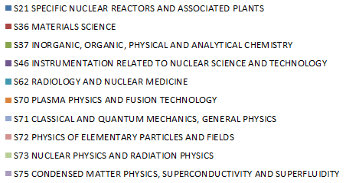
INIS Collection
3.6 million bibliographic records
470.000 full-text documents (NCL) (13.5%)
120,000+ annual input
INIS Collection by Subject Area
March 2013: 3,523,512 records

Slide 7
INIS Collection (cont.)
March 2013: 3,523,512 records

Slide 8
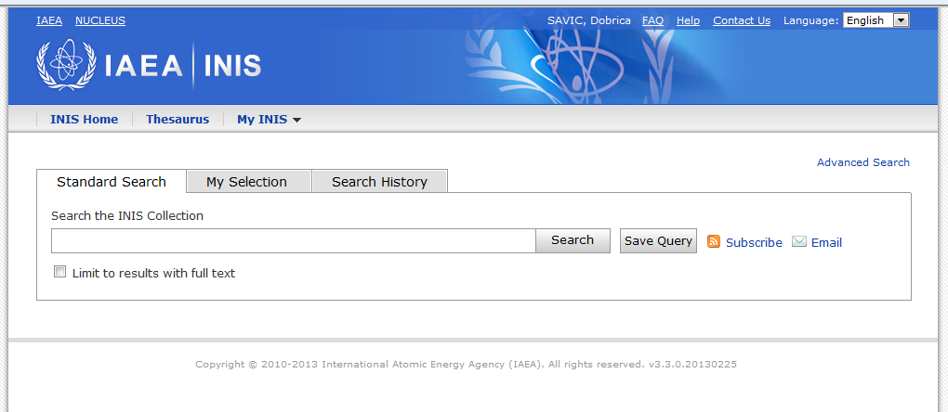
INIS Collection Search (ICS)
Old search
inis.iaea.org/search
1970-2011
Key achievements
Uncluttered, easy to use interface
Helpful advanced options to broaden or tighten a search
Relevant results (results you are actually interested in)
Around 50,000 searches and 3,000 downloads a month
New search
2011

Slide 9



ICS Main Features
  Accessibility
    Free and open web access
  Coverage
    One access point to:
      Integrated INIS
      IAEA Library collection
      IAEA Meetings on Atomic Energy (MoAE) database
    Full-text, bibliographic records and metadata, conferences on nuclear energy
  Platform
    Google Search Appliance© technology - renowned, simple, fast, flexible
    Project started in 2010. Current version 4.1, June 2013
    Replaced old BASIS INIS Online DB

Slide 10
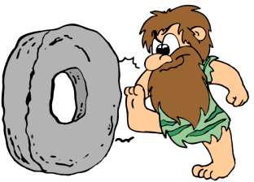

ICS Main Features (cont.)
  Usability
    Easy to use standard or advanced (complex) search
    Metadata and Boolean search
    Browse by subject category
    Possibility to select records/fields and export results in different formats (PDF, HTML, Excel, XML, Print)
    Citations download (plain text, RIS format)
    Reference management (EndNote, RefWorks)
    Creation of RSS feeds
    E-mailing search results as a link
    User profiling
      Personalization, query saving, search updates
      Workspace concept: found documents associated with the user profile

Slide 11



Main Features (cont.)
  Interface
    Multilingual search and multilingual interface (8 languages)
    Integration with INIS/ETDE and Multilingual Thesaurus (7 languages)
    Integration with INIS authorities
    Dynamic navigation through country, language, publication year and INIS volume
    Stop words for languages other than English
    Translation of bibliographic records into other languages using Google Translator
  Expandability
    New collections
    INIS Collection Search widget
  Help
    Multilingual online help file (8 languages)
    Pop-up hints: examples on how to build the query using metadata

Slide 12



GSA Advantages and Disadvantages
  Google Search Appliance vs. another tool or custom implementation
    PROS
      Users’ familiarity with a Google-type interface
      Possibility to include many features in foreground or background
      Scalability
      Quick and relevant response to searches
      Many features available out of the box, with little configuration
      Easy to customize the UI by editing the XSLT
    CONS
      Cost: license for records, development, daily running and maintenance
      GSA index and/or database is not under administrator’s control
      GSA is a search tool. It is not a collection management tool, not a reporting tool, and not a statistical tool
      Limitations in building queries: wild card search is not possible

Slide 13
Nothing endures but change!
Heraclitus (2500 years ago)
Thank you!

