Slide 1
Digital Preservation at
International Nuclear Information System (INIS)
Dobrica Savić & Germain St-Pierre
Nuclear Information Section, IAEA
Vienna Austria

Slide 2
Contents
About INIS
INIS Collection
NCL Processing and Distribution
INIS NCL Collection on Microfiche (1970-1996)
INIS Imaging System (INISIS) (1997-2003)
First Steps in Digitization: Imaging Pilot Project (Summer 1995)
INIS Imaging System 2000 (INISIS2K) (2003-2009)
Current Technical Infrastructure (2010 to present)
Microfiche Digitization Project
Other Digitization Activities
Conclusions

Slide 3
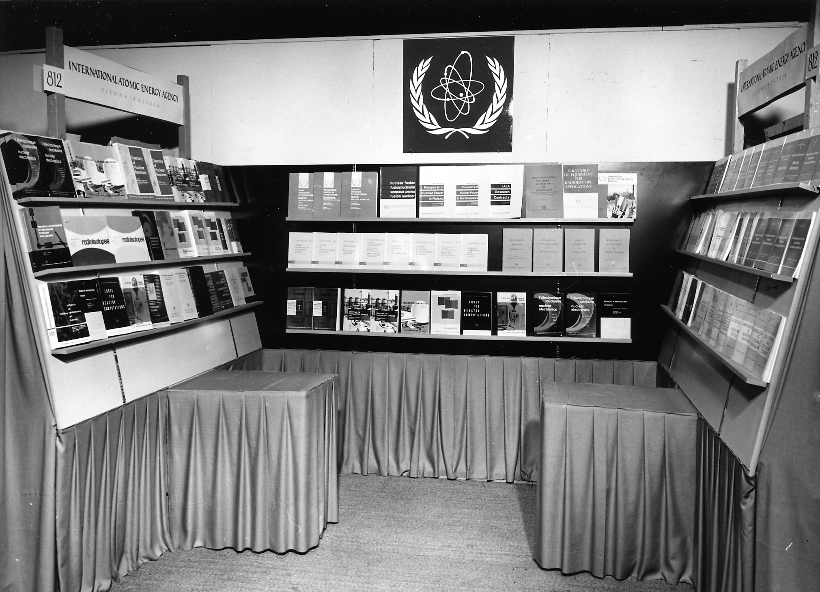
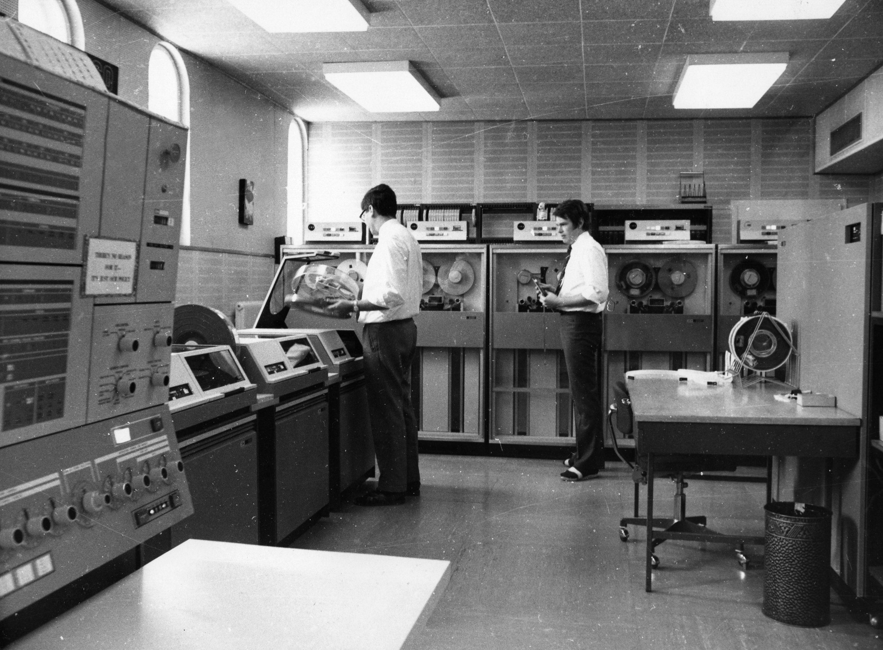
International Nuclear Information System (INIS)
One of the world's largest collections of published information on the peaceful uses of nuclear science and technology
43 years of international cooperation
Operated by the IAEA in collaboration with 128 countries and 24 international organizations

Slide 4
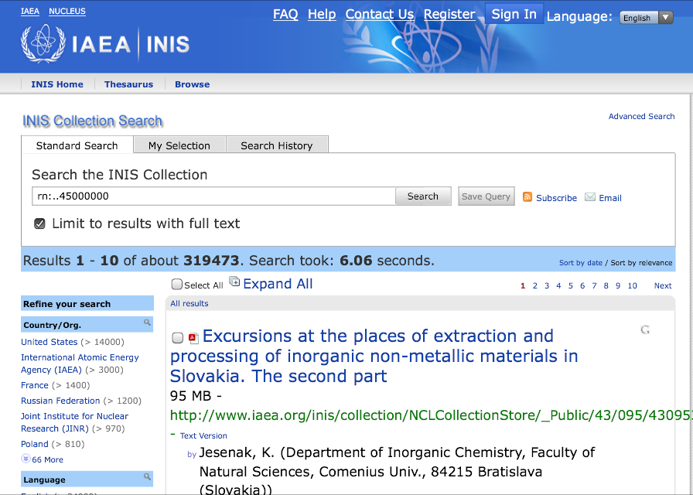
International Nuclear Information System (INIS)
Free online access to a unique collection of non-conventional (grey) literature www.iaea.org/inis
Sophisticated Google-based search engine
Unique multilingual nuclear thesaurus

Slide 5
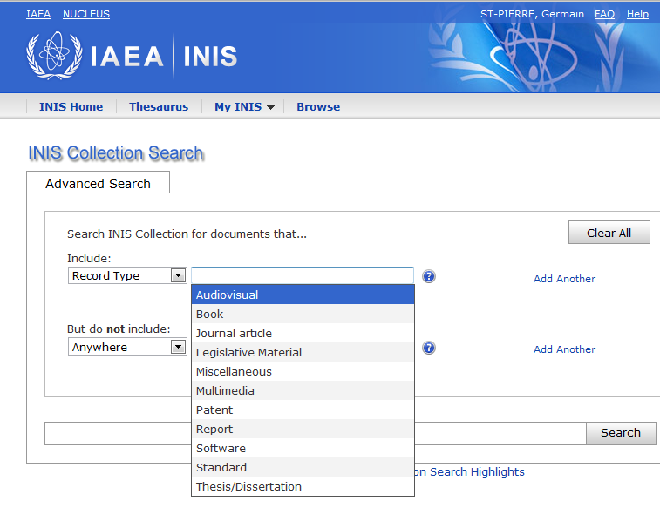
INIS Collection
Over 3,5 million bibliographic records
More than one million NCL records
Around 320,000 full-texts in PDF
Reports, journal articles, books, legislative materials, multimedia, patents, software, standards, thesis/dissertations

Slide 6
INIS Collection
70% of all NCL (over 700,000 items) available in electronic or microfiche format
Around 300,000 NCL items available from other sources
Digitization of the microfiche collection is ongoing
The INIS Collection counts over 480,000 full-texts in PDF (status 2013-10-24)
  Around 320,000 full-texts are publicly available
  160,000 full-texts require clearance procedure

Slide 7
NCL Processing and Distribution
 | Production System | NCL Processing | NCL Distribution
1970-1996 | Microfiche-based (B&H, TDC Documate, Anacomp) | Conversion from paper to microfiche (Note: NCL from U.S.A. and Japan received on microfiche) | Diazo duplicates
1997-2003 | INISIS Image-based (JouveScan) | Conversion from paper to TIFF | NCL CD-ROM with INISIR viewer
2003-2009 | INISIS2K (InputAccel) IDPS (Livelink) | Conversion from paper to PDF + OCR Ingestion of PDF files | NCL CD-ROM Online access (subscribers only) E-mail / FTP
2010 to present | NCL Collection System (PixEdit + ABBYY FineReader) | Conversion from paper to PDF + OCR Ingestion of PDF files | NCL DVD Free online access E-mail / FTP

Slide 8
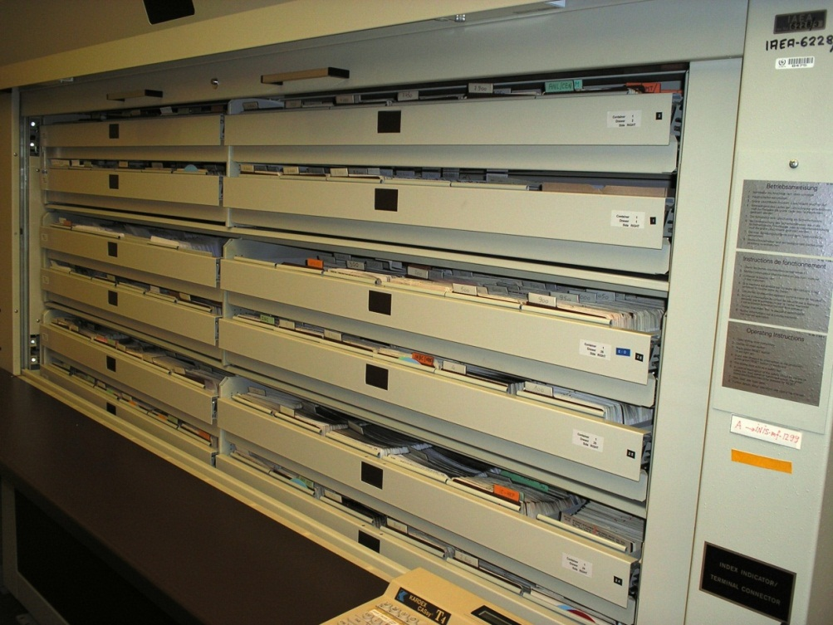
INIS NCL Collection on Microfiche (1970-1996)
  312,000 NCL reports on microfiche
  500,000 bibliographic records
  Over 1 million physical microfiches (≈ 17 million pages)
  Diazo duplicates sent to INIS customers

Slide 9
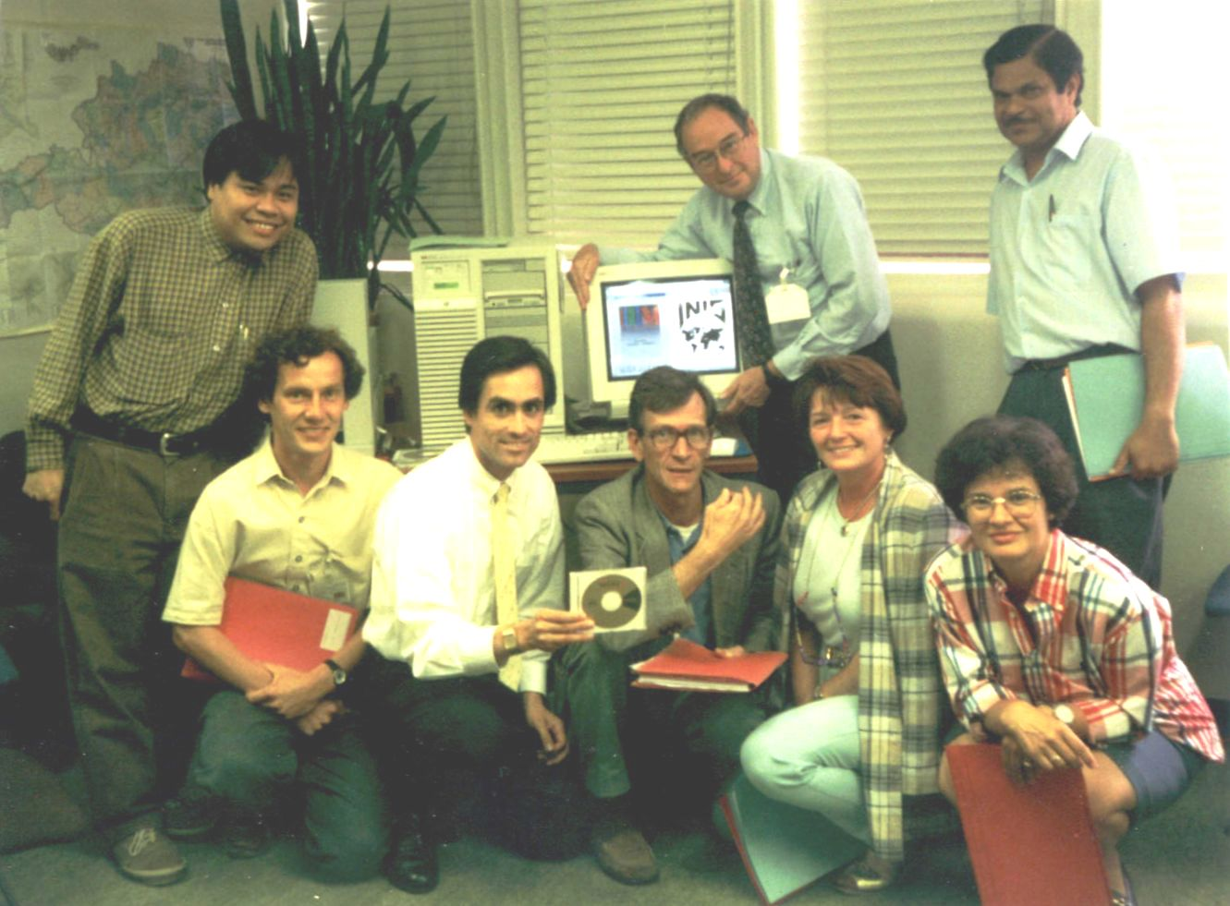
First Steps in Digitization: Imaging Pilot Project (Summer 1995)
  There is always a beginning to a success story
  B/W scanning, document feeder, but no duplex scanner available
  Output: the first CD burned on the IAEA premises

Slide 10
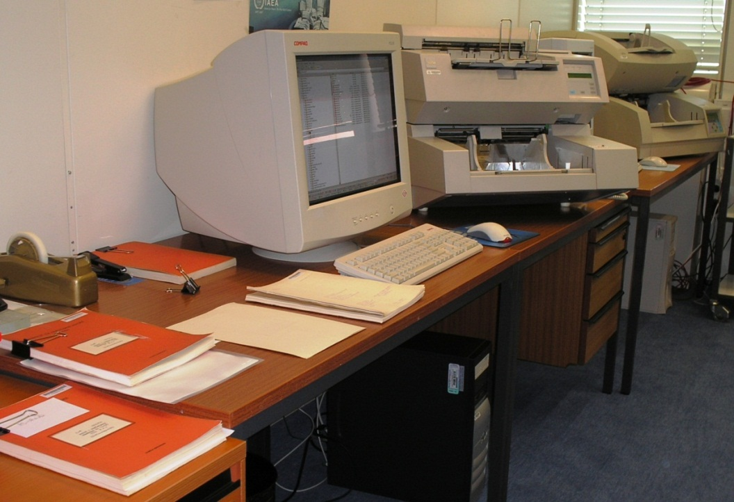
INIS Imaging System (INISIS) (1997-2003)
  Image-based production system by Jouve Systems
  B/W scanning, image enhancement, link to bibliographic metadata using bar codes, validation and CD image creation
  Format supported: single-page TIFF Group 4
  2 b/w Fujitsu production scanners, 5 workstations, 2 servers

Slide 11
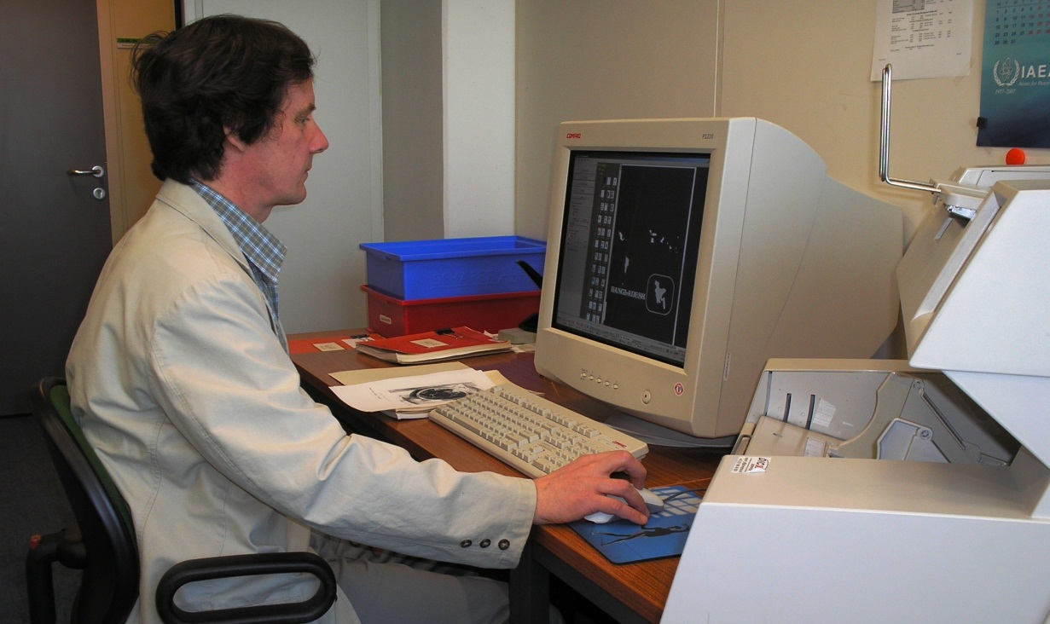
INIS Imaging System 2000 (INISIS2K) (2003-2009)
  32-bit modular Capture System (EMC InputAccel)
  B/W, Greyscale and Color Scanning, OCR, output to PDF
  Integration with Livelink-based INIS Data Processing System (IDPS)
  2 B/W Fujitsu production scanners, 1 Kodak i260 color scanner, dedicated workstations for image enhancement and OCR

Slide 12
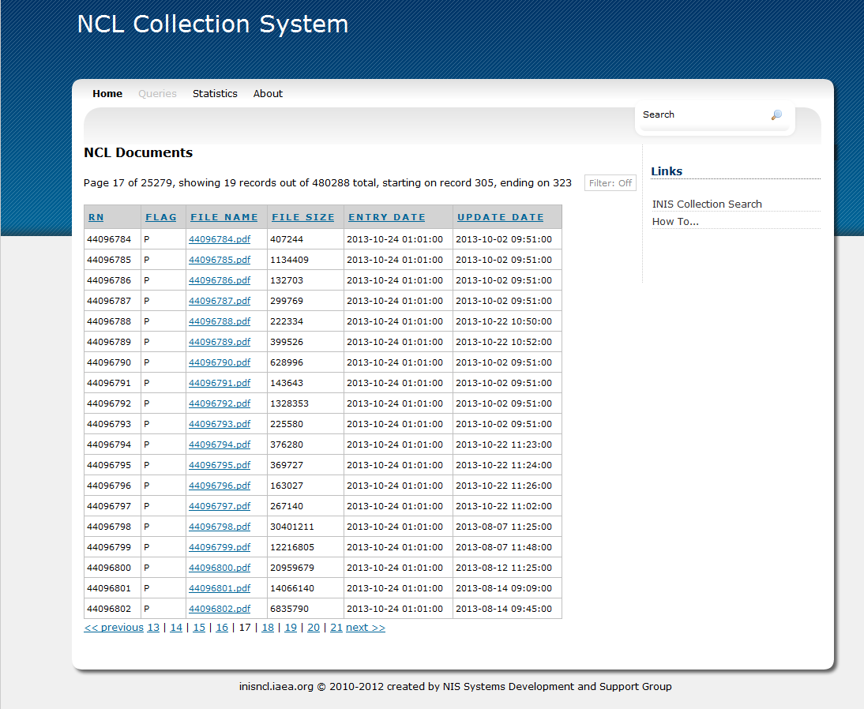
Current Technical Infrastructure (2010 to present)
Robust NCL Collection System to support its continuous growth
Flexible tools to support different projects:
  PixEdit 7 (scanning, image enhancement)
  ABBYY FineReader Corporate Edition 11 (multilingual OCR)
2 scanners (Fujitsu fi-5750c with VRS, Kodak i1440) that support color, greyscale and b/w scanning
2 Sunrise microfiche scanners
4 workstations with quad-core processors

Slide 13
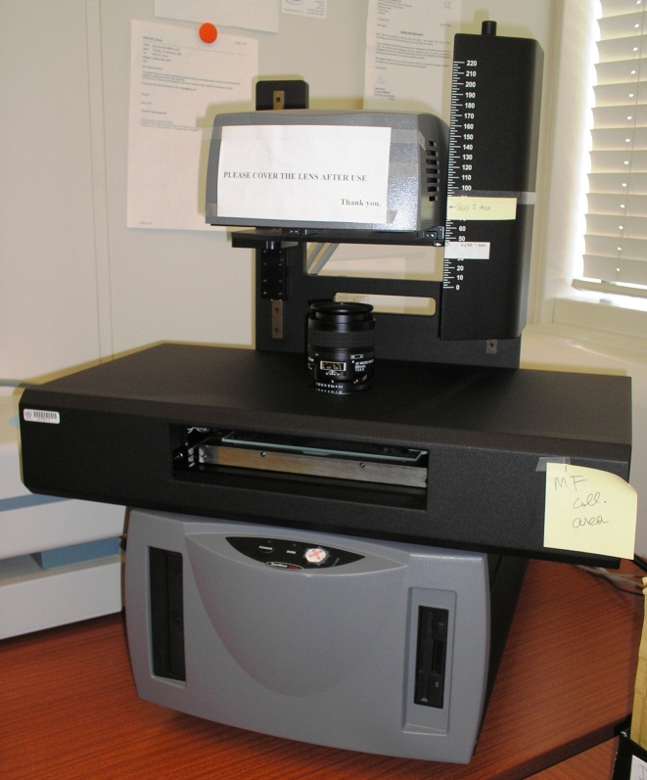
Microfiche Digitization Project
The microfiche digitization started in 2002 as support to document delivery service
Scanning part had to be outsourced to 3 different companies
Image enhancement, OCR and output to PDF done in-house
2 Sunrise microfiche scanners (300 true dpi)
Special scanning utility (Scanflow)
Image enhancement with PixEdit 7
OCR with ABBYY FineReader 11

Slide 14
Other Digitization Activities
Support digitization initiatives from Member States
    France, Mexico, Sweden, USA, Serbia, etc.
Digitization of old IAEA publications
  Proceedings Series, Safety Series, IAEA Bulletin, IAEA Board of Governors,
  International Nuclear Data Committee (INDC), etc.

Slide 15
Conclusions
Digitization projects require:
  serious planning
  substantial funds
  qualified staff (internal or external)
  awareness of standards
  well defined purpose
  Maintenance of high quality digitization process is a must
  Document preparation, selection of proper scanning techniques, type of equipment, and adherence to current standards, determine digitization success or failure
Digitization should not be a goal in itself - its ultimate use and usefulness must always be taken into account
Meaningful and searchable metadata should accompany any digitized collection, making online search and retrieval efficient
Long term preservation needs to be considered in order to ensure future sustainability and availability of the digitized collection

Slide 16
Nothing endures but change!
Heraclitus (2500 years ago)
  Thank you !

