Slide 1
The Role of the International Nuclear Information System (INIS) in Supporting
Nuclear Education and Industry, 22 – 24 October 2013, Moscow
The Future of Nuclear Information
Dobrica Savić
Head of the Nuclear Information Section
IAEA, Vienna
Notes:
Good afternoon ladies and gentlemen,
It is my pleasure to deliver this presentation on behalf of Mr Savic, Head of the Nuclear Information Section, who unfortunately was not able to personally attend this regional conference.
I would like to extend his sincere thanks to our Russian counterparts for organizing this conference and to convey his wishes for the hard work done to make this important gathering both successful and useful.
The main topic of this presentation is the future of the information world and the organizations that are directly involved in collecting, processing, and delivering information. In particular nuclear information.

Slide 2

Contents
Past
Present
Why should we care?
Challenges
Future
Conclusions
Notes:
Here is a quick overview of the presentation and a view to the future which is just around the corner, and, in many instance,s already part of the present.
I would like to emphasize that nuclear information cannot be viewed outside the wider content of scientific information and the world of libraries and specialized information centres – nowadays fashionably called “knowledge centres”.
In other words, the future of nuclear and scientific information is going to be closely related to the future of information and libraries in general.
That is the reason I am starting with the PAST, which is mainly the past of libraries as we used to know them.

Slide 3
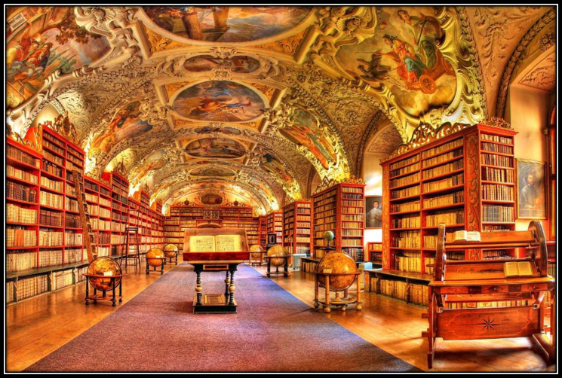

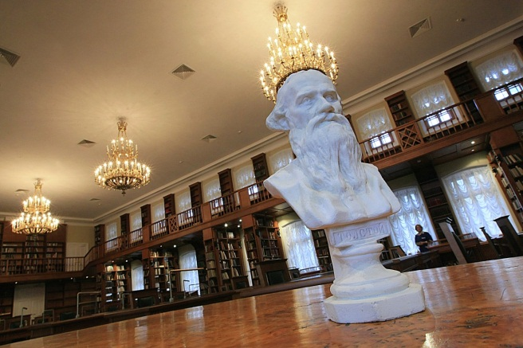
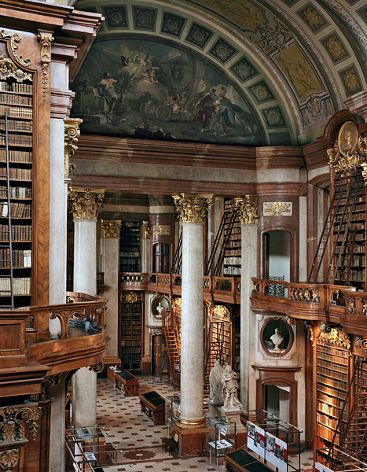
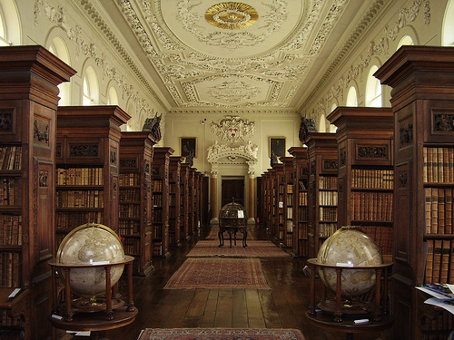
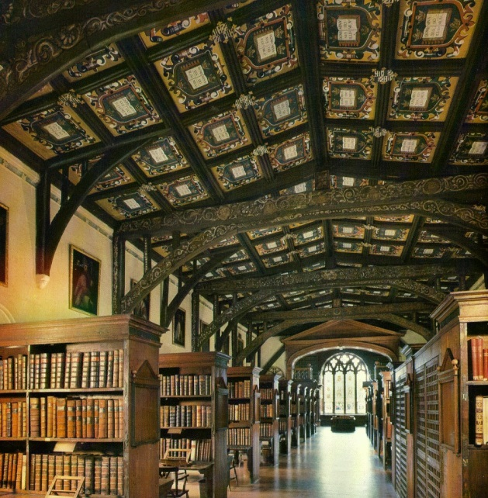
Past
Moscow
Prague
Washington, D.C.
Oxford
Vienna
St. Petersburg
Notes:
The past may not always have been as easy as the present, but it was very definitely very beautiful!
Here are photos of several libraries around the world, still active in some ways, but preserved as museums.

Slide 4
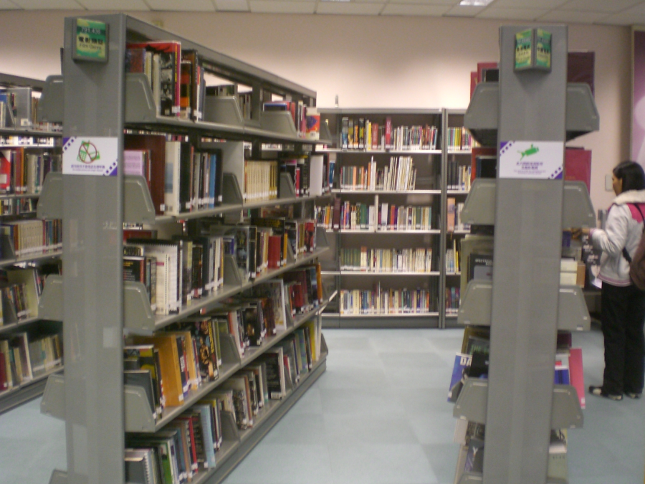
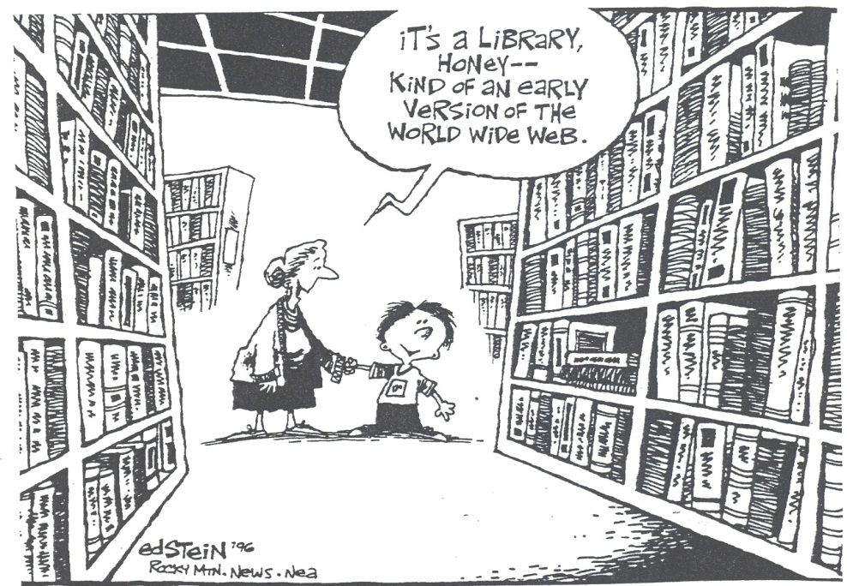
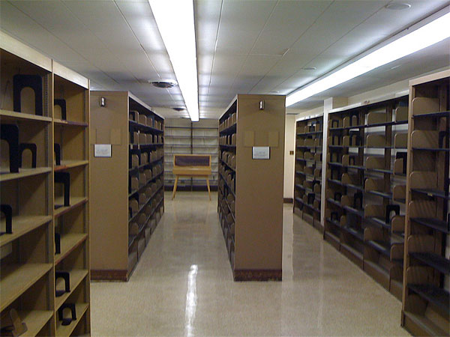
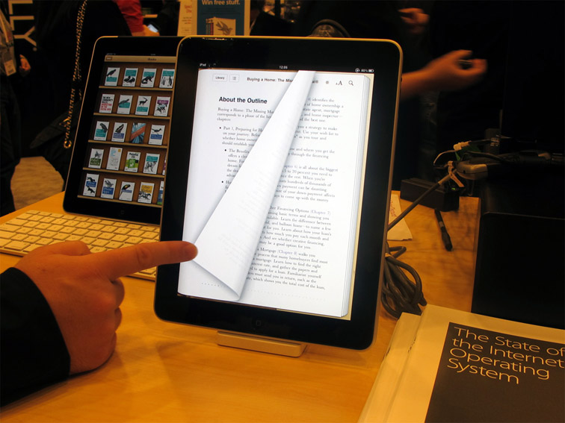
Present
Notes:
The present is not as beautiful. Rows of industrial metal shelves, many of them empty because of lack of funds or closures.
The new generation is already a stranger to libraries. Computer terminology needs to be used to explain to them what a library is, or that reading a book is like installing new software in our heads.
But the present also holds some elements of the future. iPads and Kindles are becoming a part of the regular library décor.

Slide 5

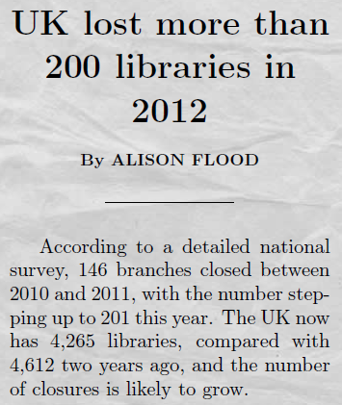

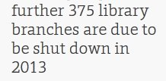
Why should we care?
Many of them are specialized scientific and technical libraries!
Notes:
Are there any reasons that we should worry about the current situation?
These are two actual press clippings from England, telling us that the UK lost more than 200 libraries in 2012 and that a further 375 library branches are due to be shut down in 2013.
This is alarming!
It is especially alarming since we know that many of these libraries and information centres are specialized scientific and technical places which store, among other materials, documents and publications related to nuclear science and technology.

Slide 6
Why should we care?
Skolkovo Moscow School of Management
  On the list of 30 professions that will disappear within the next 5-10 years, librarians are listed first!
Digital Book World
  Librarians: a dying breed? Will librarians go the way of the soda jerk, telephone operator and travel agent?
The Now Newspaper
  Libraries could be going the way of the video rental store; technology training programs offered on site… that's a big part of what libraries do
CNN
  Library is dying - and it's taking its shushing ladies, dank smell and endless shelves of books with it
Bain & Company (publish a regular report on management tools and trends; 1200+ global CEOs)
  KM (glorified Information Management) dropped from the 10th most popular tool in 2006 to out of top 25 in 2012
Notes:
Lets look together at some of the main messages sent to readers regarding the information profession:
(… read one by one item from the screen…)

Slide 7
Challenges
Current environment Challenges
Aging technology & n-power plants - Increased demand for information
Knowledge drain (retirement, turnover) - Adequate replacement, search for
alternate information sources
Information silos - Obtaining fast and open access
Paper collections - Retrieval, preservation, e-content
Legacy systems - Readability & usability of data/info,
computer centred processing
Labour intensive systems - Lack of qualified and experience staff
Limited (diminishing) funding - Rising collection/processing costs
Need to generate revenue - Showing the information value
Physical space & presence - Virtual workplace & workforce
Information security/confidentiality - Cloud services and tools
Lack of respect for Copyright - DMR, use of open source
Expensive subscriptions to journals - Open source, social media,
& databases trustworthiness, reliability
Notes:
Aging technology and aging nuclear power plants increasingly require additional maintenance and management, which in turn increases demand for all kinds of information resources, which are sometimes difficult to find.
Retirement and frequent staff turnovers in nuclear industry and education place a growing demand on finding alternate resources of reliable information. Knowledge preservation was not a high priority at the time that some of this technology was built and introduced.
Unfortunately, information was too often regarded as tool for power plays and positioning. There are too many information silos even today, when we need fast and open access to info.
Paper collections and legacy systems create problems in retrieval, readability and usability.
Previous labour intensive and expensive information systems are hard to maintain due to a lack of qualified and experienced personnel and limited funds.
Most of the time it is difficult to quantify the financial value of information and to prove that it generates revenue or creates savings.
Real estate and office space is becoming a considerable expense, so there is an increased demand for virtual workspaces, while remote workforces create additional challenges.
Information security and confidentiality, copyright, proprietary information and other related issues are also placing huge demands on providers of nuclear and other information
The cost of subscriptions to journals and databases is also rising.

Slide 8

Future
INFO
Rmat
I
O
n
● Digital multimedia content
● Subscriptions to discovery
services, DBs, large
publishers/suppliers
● Open access documents
● Internal publications
● No physical space
● All Digital
● Web presence
● Virtual / Cloud space
Environment
Collection
● Direct problem solving
● Knowledge creation
● Training
● Action oriented
● DRM management
● Interactive & integrated
● Full text
Role
Services
● Remote access
● Temporary employees
● Sophisticated users
● Outsourcing
● Extensive automation
● Simplification
● Mobile devices, apps
● Social media /
crowdsourcing
Users
Tools
Notes:
So what will the future of information in general, as well as the future of nuclear information most likely be?
We can look at the future by emphasizing 6 different assets of information:
Information environment
All digital, no physical space, only virtual of web presence
Information collection
All digital in all file formats; rise of discover services, information aggregation, open source publications, no ownership on digital items as is the case with paper based
Role of information
Direct role in problem solving, knowledge creation, action oriented with huge emphasis on training
Services
Help organizations with Digital Rights Management (DRM), integration with other services, access to full-texts
Users
Remote access, temporary and very sophisticated workers, outsourcing
Tools
Extensive automation, simplification, mobile everything, social media
(RED BOXES indicate the most important element of each information facet!)

Slide 9
Conclusions
The world of scientific and nuclear information has changed dramatically
The pace of change does not appear to be slowing
Scientists now have access to an enormous quantity of information and an array of tools available to collect, process and retrieve the data
Although very rich, the current information environment is full of various challenges
Changes have to encompass all facets of information work
The future of scientific and nuclear information depends on efforts to quickly and efficiently introduce the required changes
Nuclear information needs to be better organized and made available through a multitude of channels
Nuclear information can influence and increase participation from the scientific community, facilitate collaboration and ultimately accelerate scientific and technological progress
Notes:
(… read one by one item from the screen…)

Slide 10
Nothing endures but change!
Heraclitus (2500 years ago)
Thank you!
Dobrica Savić
d.savic@iaea.org

