Slide 1
OPEN ACCESS TO NUCLEAR INFORMAITON
GreyForum 3.1 – Grey Literature and Policy Development: The Pisa Declaration
7 April 2014, Pisa
Dobrica Savić
d.savic@iaea.org
Nuclear Information Section
IAEA, Vienna

Slide 2
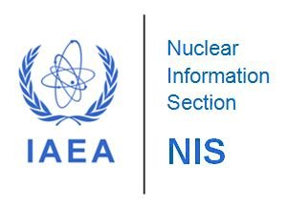
Contents
‘Open’ definition
Open access
Drivers of open access
IAEA and Nuclear Information Section
Open access at IAEA/NIS
INIS Collection
INIS Collection Search
Conclusions
Organizing the world's nuclear information and making it universally accessible

Slide 3
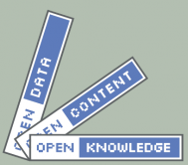
1. ‘Open’ definition
Knowledge - includes content such as music, films, books, data (scientific, historical, geographic or otherwise), government and other administrative information
Work - denotes the item or piece of knowledge which is being transferred
A work is open if its manner of distribution satisfies the following conditions:
Access: Work must be available at no cost in a convenient and modifiable form
Redistribution: Work can be sold or given away by any party on its own or as part of a package
Reuse: Modifications and derivatives can be distributed under the terms of the original work
Absence of technological restrictions: Use of an open format (specifications are publicly and freely available without monetary or other restrictions)
Attribution: Attribution of the contributors and creators may be required
Integrity: If the work is distributed in modified form, the result should have a different name or version number from the original
No discrimination against persons of groups: Works should be open to everyone
No discrimination against fields of endeavor: No restrictions for business use
Distribution of license: The rights attached to the works must apply to all of its redistributions without the need for an additional license
License must not be specific to a package: The rights attached to the works must not depend on the data being part of a particular package
License must not restrict the distribution of other works: No insistence that all other works distributed on the same medium are open
Source: http://opendefinition.org
Open data, open government, open educational resources, free and open-source software, open science, etc.

Slide 4
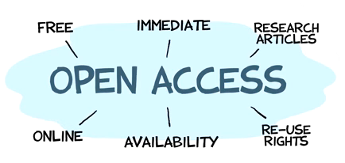

2. Open access
Open access (OA) – unrestricted on-line access to scholarly journal articles, theses, books, chapters, grey literature
Open access can be:
Gratis OA (free online access)
Libre OA (free online access plus some additional usage rights often granted through Creative Commons licenses)
Authors can provide open access through:
Green OA: Self-archiving their journal articles in an OA repository
Gold OA: Publishing in an open access journal
Directory of Open Access Journals (DOAJ)
  9,709 registered journals
  1,598,913 articles
The Directory of Open Access Repositories (OpenDOAR)
  Over 2,500 listings

Slide 5

3. Drivers of open access
Knowledge-based economy
  A greater reliance on intellectual capabilities than on physical inputs or natural resources
  Globalization
  Products and services
  Research-development-new technology-production
The knowledge worker
  Access to information
  Free use and reuse of information
  Distribution of knowledge products
Developments in ICT
  PCs/laptops/mobile devices
  Networks
  ePublishing
Growth of Internet
  Worldwide coverage
  Affordability
  Popularity
  Social media
Outdated scientific publishing model
  Cost
  Time
  Availability
Scientific knowledge spreads and increases faster if there are no restrictiona to it!

Slide 6
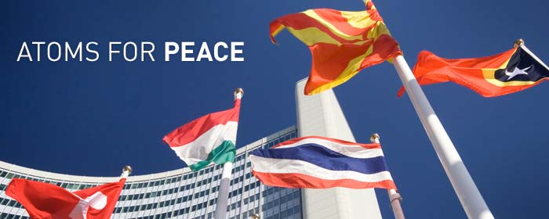

4. IAEA and Nuclear Information Section (NIS)
International Atomic Energy Agency (IAEA)
  The world's leading Agency for cooperation in the nuclear field
  Created in 1957 as part of the United Nations family
  The IAEA works with its 162 Member States and multiple
  partners worldwide to promote safe, secure and
  peaceful uses of nuclear technologies
  The IAEA Secretariat is based in Vienna, Austria, with 2300
  multi-disciplinary professional and support staff from more than 100 countries
Nuclear Information Section (NIS)
  Consists of the International Nuclear Information System (INIS), the IAEA Library,
  and the System Development and Support Group (SDSG)
  The objectives are to:
    foster the exchange of scientific and technical information on the peaceful use of nuclear science and technology (collect, process, preserve and disseminate)
    Make the INIS Collection of publications freely available to all Internet users
    increase awareness in Member States of the importance of maintaining efficient and effective systems for managing nuclear information resources
    assist with capacity building and training
    provide information services and support to Member States & the IAEA

Slide 7

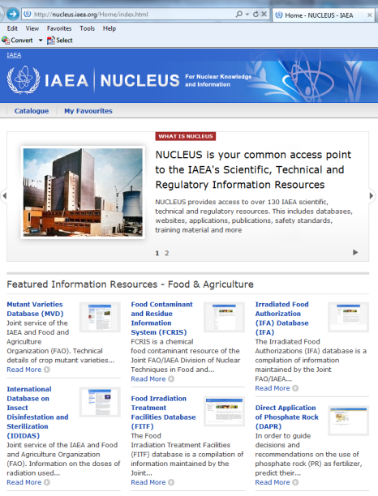
  5. Open access at IAEA/NIS
All IAEA publications are freely available on the IAEA website in PDF
NUCLEUS is a common access point to over 130 IAEA scientific, technical and regulatory information resources. This includes databases, websites, applications, publications, safety standards, training material and more. Most of those data resources are open to the public.
  Database on insect disinfestation and sterilization
  Mutant varieties database
  Charged-particle section database
  Experimental nuclear reaction data
  Fusion evaluated nuclear data
  Ion beam analysis nuclear data
  Nuclear decay data
  Power reactor information system
  ZVVIEW interactive plotting of nuclear data

Slide 8

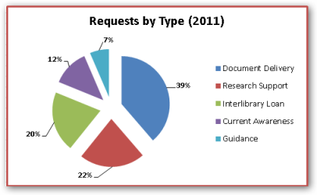
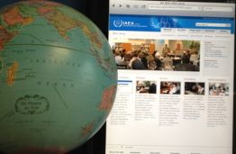
  5. Open access at IAEA/NIS (cont.)
Free, open and unrestricted access to the INIS Collection (3.6 million records and 320,000 full-texts); 152 members
www.iaea.org/inis
Free and open cooperation with 50 member libraries of the International Nuclear Library Network (INLN)
IAEA Library offers free access to its collections and free information services to its users, including visitors to the Vienna International Centre (VIC)

Slide 9
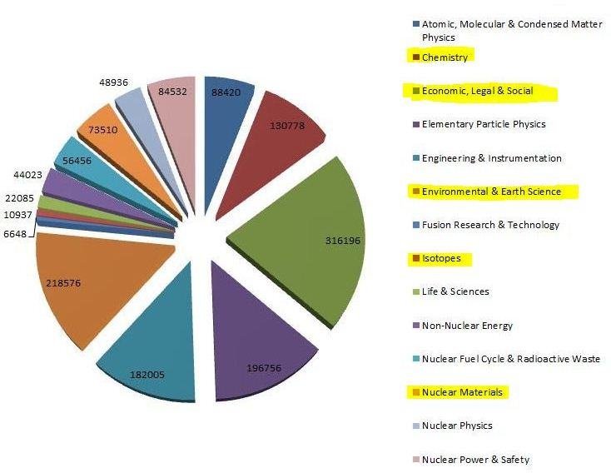
6. INIS Collection
120,000+ annual input
1 January 2014: - more than 3.6 million bibliographic records
- 482,951 full-text documents (NCL) (13.4%)
INIS Collection by Subject

Slide 10
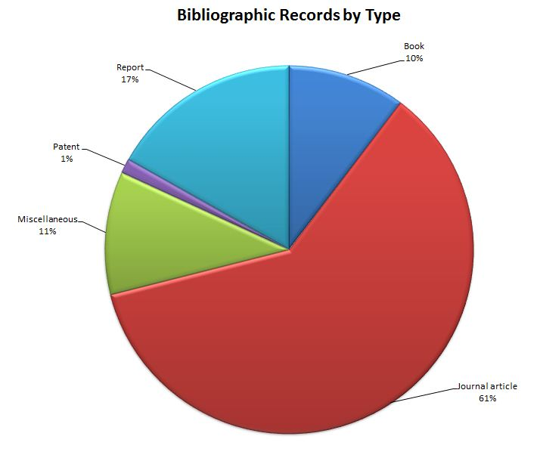
6. INIS Collection (cont.)
1 January 2014: 3,623,201 records

Slide 11
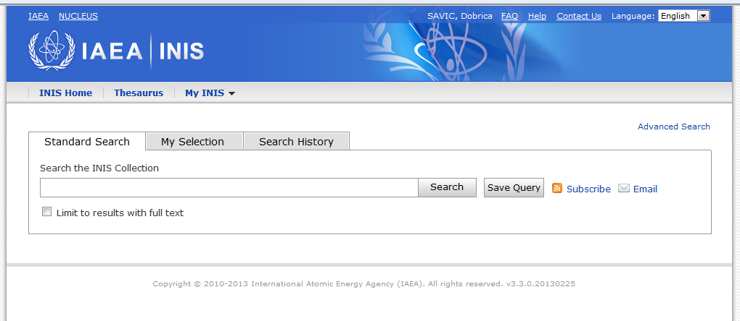
7. INIS Collection Search
Old Search 1970-2011
Required 2-step registration
Cluttered interface made for librarians
Not easy to use (advanced search only)
Full-text indexing not implemented
Limited speed (outdated technology)
No exports of metadata or user profiling
New Search 2011
inis.iaea.org/search
Free and unrestricted access through Internet
New technology (Google Search Appliance)
Tremendous speed and scalability
Uncluttered, easy to use start-up interface
Advanced options to broaden or tighten search
Full-text indexing; More relevant results;
Faceted/filtered search
      Impact of opening access to
      Google.com and Google Scholar
      2013: 50,000 searches and 3,000 downloads a month
      2014: 250,000 searches and 41,000 downloads a month

Slide 12
8. Conclusions
On one hand
Public sector wants to improve delivery of their products and services
Tremendous amount of information is available on the Web
Open access makes information and data discoverable
Value of information and data is increased through open access
Empowers people to make more informed and better decisions
On the other hand
More worry about look-and-feel than about user access ■
Information needs to be easier to find, access and navigate ■
We will build and they will come ■
It takes money to provide open access ■
  Open access is not a project ■
  Open access is a means not an end-in-itself ■
  Open access should lead to quality information and data ■

Slide 13
Being open means lowering barriers to ensure the widest possible use!
Thank you!

