Slide 1
Digital Preservation at INIS
United Nations Library and Information Network for Knowledge Sharing (UN-LINKS)
24 - 26 October 2012, Rome
Dobie Savić
Head, Nuclear Information Section (NIS)

Slide 2

Contents
INIS overview
INIS activities
Digitization
  INIS microfiche collection
  Print IAEA publications
  New incoming NCL
Lessons learned
for peaceful uses of nuclear science and technology

Slide 3
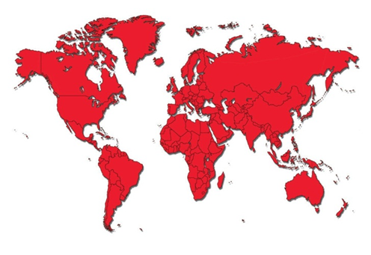
INIS Overview
INIS
One of the leading worldwide reference collections of scientific literature on the peaceful uses of nuclear science and technology
Established in 1970 in response to the IAEA’s mandate to “foster the exchange of scientific and technical information on peaceful uses of atomic energy”
IAEA/NIS: INIS, Library & SDSG
International Cooperation
Operated by the IAEA in collaboration with 128
Member States and 24 international organizations
INIS Collection
Over 3.4 million bibliographic records
320,000 full text documents. In total 462,000 NCL
Comprising of scientific and technical reports, conference proceedings, patents and theses not available through commercial channels
Range of subjects: nuclear engineering and technology, nuclear safety and radiation protection, safeguards and non-proliferation, nuclear and isotopic techniques, sciences relevant to nuclear research, nuclear and high energy physics, radiation chemistry, legal aspects of nuclear power, environmental and economic aspects of nuclear and non-nuclear energy sources
Free, open and unrestricted access is available at: www.iaea.org/inis using the INIS Collection Search, based on the Google search technology

Slide 4
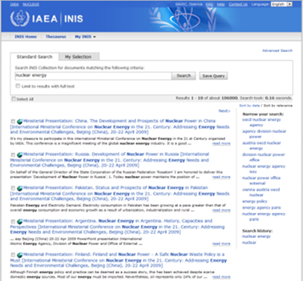
INIS Activities
INIS Collection
Web (online) and CD/DVD (offline) access
Building and maintaining IAEA-INIS/ETDE Thesaurus
ar de fr en es ja ru zh
Digitizing and preserving non-conventional nuclear literature
Over 462,000 NCL
including full text reports from Member States
IAEA publications and policy documents are available in electronic format
Capacity building and outreach
Establishment and improvement of a national information infrastructure in Member States
Staff training programmes for national INIS centres

Slide 5
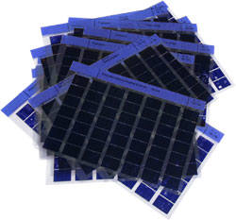
  Digitization of INIS Microfiche Collection
Since its creation in 1970 until 1996, INIS collected and converted to microfiche over 312,000 non-conventional literature (NCL) reports received from member states and international organizations.
The microfiche collection contains over 1 million items, with an estimated total of 25 million pages of full-texts.
In 1997, the INIS Secretariat replaced the microfiche-based production system with an imaging system to process and to disseminate all NCL documents in electronic format.

Slide 6
  Digitization of INIS Microfiche Collection (cont.)
Digitization of the INIS NCL Collection on Microfiche started in 2003
Close to 80% of the microfiche collection digitized
3 million pages still remain on microfiche
Part of the digitization done internally
Large part or digitization outsourced, while internal quality control maintained
Each digitization effort was preceded by efforts to avoid duplication
Close collaboration with INIS Member States
Year | PDF | Pages | Size (GB)
2003 | 566 | 49 574 | 3.7
2004 | 19 962 | 1 325 217 | 36.5
2005 | 36 935 | 1 577 365 | 32.1
2006 | 23 163 | 1 367 637 | 33.3
2007 | 9 313 | 668 769 | 16.3
2008 | 25 675 | 1 228 057 | 29.7
2009 | 81 221 | 3 939 811 | 77.3
2010 | 33 881 | 1 969 110 | 45.9
2011 | 24 027 | 511 990 | 16.2
2012 | 20 434 | 843 579 | 40.7
Total: | 275 177 | 13 481 109 | 331.8

Slide 7
  Digitization of INIS Microfiche Collection (cont.)
INIS Image creation Process
Benchmarking (probability for success, digitizing requirements)
Source material types (printed, microfiche, drawings and formulas)
Preparation (physical, structural, conditions/characteristics)
Scanning (capture mode/bitonal/grayscale/colour, optical resolution 300-600 dpi bitonal, 200-300 dpi colour/greyscale)
Quality control (accuracy and completeness, data integrity, metadata correctness, ‘checksum’ for authenticity and integrity of digital files)
Image enhancement (despeckling, deskewing, noise reduction, black border removal; colour and tone adjustment)
File formats (TIFF Group IV, PDF, PDF/A)
Compression (JBIG2 for black & white web optimization, JPEG for color)
File naming convention (required consistency throughout the Collection)
Optical character recognition (OCR) (ABBYY FineReader and Adobe Acrobat)
Storage (online, offline Blu-ray discs, and offsite storage)
Preservation planning (migration, emulation, refreshing)
Metadata creation (technical metadata and bibliographic metadata)

Slide 8
  Digitization of INIS Microfiche Collection (cont.)
INIS digitization software
Techsoft PixEdit v.7.11.18 (advanced image editing)
ABBYY FineReader 11 Corporate Edition (OCR)
Adobe Acrobat X Professional (conversion to PDF/A, OCR of Chinese Simplified, Japanese and Korean)
Kofax Virtual ReScan (VRS) + Kodak Perfect Page (image enhancement)
INIS digitization hardware
Scanner | Type | Paper size | Resolution (dpi) | Bit-in-depth | Speed (A4, 200 dpi) | ADF Page capacity
Fujitsu fi-5750c with VRS Pro | Colour; ADF/flatbed | A8 – A3 Up to 34 inches | 50 to 600 | 24 | 110 p/min (simplex) 55 p/min (duplex) | 200 p
Kodak i1440 | Colour; ADF/flatbed | A5 – A3 | Up to 600 Optical Resolution 300 | 16 - 48 | 50 p/min (simplex) 100 p/min (duplex) | 150 p
SunRise 2000 | Microfiche scanner | A0-A4 reductions 7x-50x | CCD 3600-8800 True Resolution |  | Up to 2500 frames/hr
SunRise Apollo | Microfiche scanner | A0-A4 reductions 7x-50x |  |  | Up to 3600 frames/hr

Slide 9
Digitization of Printed IAEA Publications
Completed projects
  IAEA Bulletin
  IAEA General Conference
  INDC Technical documentation
  IAEA Technical Reports Series (TRS)
On-going projects
  Out of Print IAEA Publications
    Proceedings Series
    Safety Series (IAEA/NS)
  Photo Archival Project

Slide 10
Digitization of New Incoming NCL
NCL coming from 50 countries or organizations
Full-texts control
  Input mostly in PDF => Quality control
  NCL input in hard copy => Full digitization
  Digitization = Scanning + Image Enhancement + OCR + PDF output + QC

Slide 11

Lessons learned
Serious planning
Substantial funds
Staff well qualified
Standards’ awareness
Searchable metadata
Well defined purpose

Slide 12
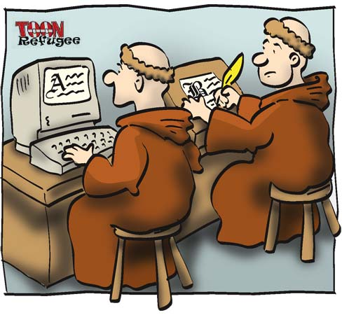
Thank you!

