Slide 1
Open Data at NIS
United Nations Library and Information Network for Knowledge Sharing (UN-LINKS)
24 - 26 October 2012, Rome
Dobie Savić
Head, Nuclear Information Section (NIS)

Slide 2
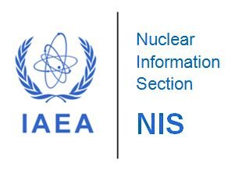
Contents
NIS overview
Open data concept
Open data requirements
Open data at IAEA/NIS
Road ahead
Conclusions
Organizing the world's nuclear information and making it universally accessible

Slide 3
NIS Overview
NIS objectives
to provide free information & services in support of the Member states and the Agency
to foster open exchange of STI on peaceful use of nuclear science and technology
to increase awareness in Member States of the importance of maintaining efficient and effective systems for managing STI on the peaceful use of nuclear science and technology
to assist with capacity building and training
INIS objectives
to collect and process metadata and e-texts of nuclear literature published in IAEA Member States
to preserve NCL, e.g. IAEA documents, reports and full-text of publications from Member States
to make INIS collection of publications freely available to all Internet users
IAEA Library objectives
to manage internal and external Library information resources
to provide of Library information services
to promote free information exchange, cooperation and resource sharing between nuclear information centres and libraries worldwide (e.g. INLN)
SDSG objectives
to support and maintain existing information systems and applications
to improve functionality of existing IT systems and develop new solutions

Slide 4
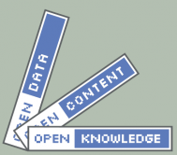
Open Data Concept
Availability and Access: the data must be available as a whole and at a reasonable reproduction cost, preferably by free download over the internet. The data must also be available in a convenient and modifiable form.
Reuse and Redistribution: the data must be provided under terms that permit reuse and redistribution including the intermixing with other datasets.
Universal Participation: everyone must be able to use, reuse and redistribute – there should be no discrimination against fields of endeavour or against persons or groups. For example, ‘non-commercial’ restrictions that would prevent ‘commercial’ use, or restrictions of use for certain purposes (e.g. only in education), are not allowed.

Slide 5
Open Data Requirements
Access: Data must be available without charge in a convenient and modifiable form
Redistribution: Data can be sold or given away by any party on its own or as a part of package
Reuse: Modifications and derivatives can be distributed under the terms of the original work
Absence of technological restriction: Use of an open data format, i.e. specifications are publicly and freely available without monetary or other restrictions
Attribution: Attribution of the contributors and creators may be required
Integrity: If the data is distributed in modified form, resulting work should carry a different name or version number from the original
No discrimination against persons of groups: Data should be open to everyone
No discrimination against fields of endeavor: No restrictions for business use
Distribution of license: The rights attached to the data must apply to all of its redistributions without the need for an additional license
License must not be specific to a package: The rights attached to the data must not depend on the data being part of a particular package
License must not restrict the distribution of other data: E.g. no insistence that all other works distributed on the same medium are open
Source: http://opendefinition.org

Slide 6

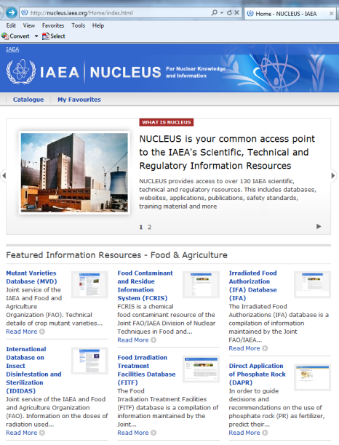
  Open Data at IAEA/NIS
All IAEA publications are freely available on the IAEA website in PDF
NUCLEUS is a common access point to over 130 IAEA's scientific, technical and regulatory information resources. This includes databases, websites, applications, publications, safety standards, training material and more. Most of those data resources are open to the public.
  Database on insect disinfestation and sterilization
  Mutant varieties database
  Charged-particle section database
  Experimental nuclear reaction data
  Fusion evaluated nuclear data
  Ion beam analysis nuclear data
  Nuclear decay data
  Power reactor information system
  ZVVIEW interactive plotting of nuclear data
  …

Slide 7

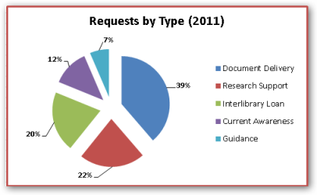
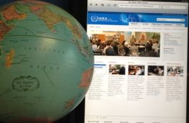
  Open Data at IAEA/NIS (cont.)
Access to INIS Collection (3.4 million records and 320,000 full-texts) is open and free through www.iaea.org/inis
Cooperation with 37 libraries members of the International Nuclear Library Network (INLN) is completely free and open to new members
IAEA Library offers free access to its collections and free information services to all of its users, including any visitor to the Vienna International Centre (VIC)

Slide 8
Road Ahead
Open access vs. open data
  Direct access to individual records
  Data subsets portability
  Creation and use of independent outside APIs
Open Nuclear Information eXchange Service (ONIXS) Project
  Open Archives Initiative Protocol for Metadata Harvesting (OAI-PMH): an application-independent interoperability framework for metadata harvesting and building of repositories
Open data developments
  UNdata data.un.org
  Open Government Initiative (USA) www.data.gov
  Open data UK www.data.gov.uk

Slide 9
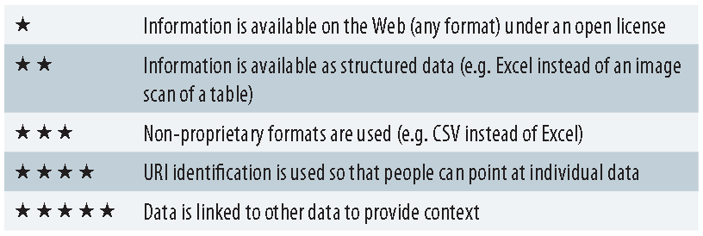
Road Ahead (cont.)
As described by Sir Tim Berners-Lee1 in his 5 Stars Model at the
Gov 2.0 Expo in Washington DC in 2010

Slide 10
Conclusions
On one hand
Improve public service delivery
We provide tremendous amount of information via Web but we have to make it:
  easier to find
  easier to navigate
  give access to the raw data
Open data makes our data discoverable
Value of our data is increased
Empowers people to make informed and better decisions
On the other hand
We spend more times worrying about CSS than we do worrying about the users ■
We will build and they will come ■
Building a user community around a tool ■
It takes money to make existing data open ■
  “Open data” is not a project ■
  Open data is a means not an end itself ■
  Most of the raw data released up to now is of low-value ■

Slide 11
Being open means lowering barriers to ensure the widest possible re-use by anyone!
Thank you!

