Slide 1
Agenda item 1.7
INIS Website Statistics and User Survey
36th Consultative Meeting of INIS Liaison Officers
4 - 5 October 2012, Vienna
Dobie Savić
Head, Nuclear Information Section (NIS)

Slide 2
Agenda item 1.7 - INIS Website Statistics and User Survey
INIS website statistics
  Collection search
  INIS website
  Members’ area
INIS website user survey

Slide 3

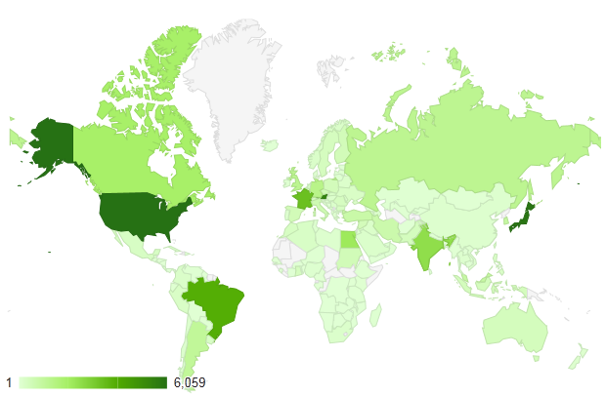
INIS Collection Search Statistics
1 January – 30 September 2012
            9 months monthly average
Visits 54,269 6,000
Unique visitors 25,727 2,900
Total unique searches 162,739 18,000
Page views 429,476 48,000
Pages/visit 7.91
Avg. visit duration 8:37
Bounce rate 37.59%
Visitors
USA
Japan
India
Brazil
France
Austria
Canada
Egypt
Germany
UK
Languages
English 49%
Japanese 10%
French 8%
Portuguese 7%
Spanish 4%
Russian 2%
Search terms
Fukushima; Nuclear safety; Chernobyl; Nuclear; Three mile island; Plasma; Electron

Slide 4

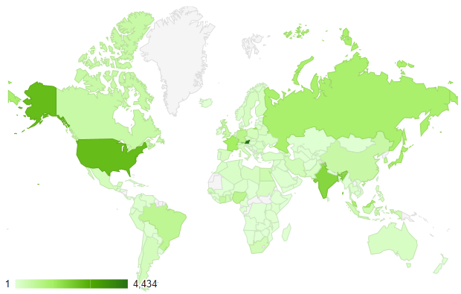
INIS Website Statistics
1 January – 30 September 2012
            9 months monthly average
Visits 32,863 3,750
Unique visitors 16,933 1,900
Page views 78,564 8,700
Pages/visit 2.39
Avg. visit duration 3:25
Bounce rate 55.69%
Visitors
Austria
USA
India
France
Japan
Russia
Malaysia
Germany
Nigeria
Brazil
Languages
English 60%
French 9%
Russian 6%
Japanese 4%
Spanish 3%
Portuguese 3%
Most frequently visited pages
Contacts, Collection, Products and services, Events, History, Site index, Thesaurus

Slide 5

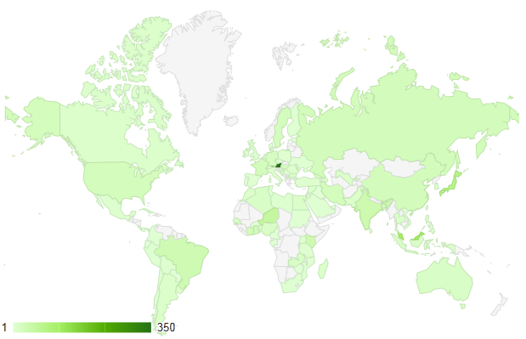
INIS Members’ Area Statistics
1 January – 30 September 2012
            9 months monthly average
Visits 1,462 160
Unique visitors 442 50
Page views 7,214 800
Pages/visit 4.93
Avg. visit duration 4:31
Bounce rate 37.69%
Visitors
Austria
Malaysia
Japan
Niger
India
Kenya
Brazil
Ghana
Côte d’Ivoire
China
Languages
English 64%
French 10%
Japanese 5%
Spanish 3%
Portuguese 2%
Russian 2%
Most frequently visited pages
Correspondence/Information letters, Statistics, Membership agreement

Slide 6

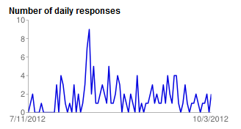
INIS Website User Survey
The 35th Consultative Meeting of the INIS Liaison Officers recommended that a standard INIS user needs survey tool be developed and made available.
The objective of the survey was to collect answers to the following questions:
Who is using the INIS website and the INIS Collection
Why are users accessing our website
Do they find what they are looking for
Are they satisfied with the look and performance of the website
The Survey contained 15 questions
  11 multiple choice
  4 open-end questions
It was placed on the INIS website on 12 July and closed on 3 October 2012
133 replies were received and analysed

Slide 7
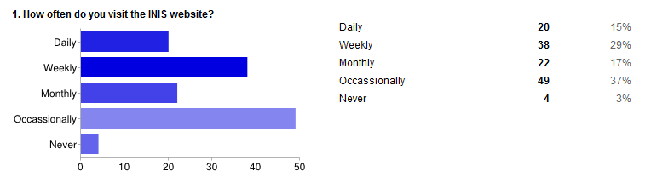
INIS Website User Survey

Slide 8
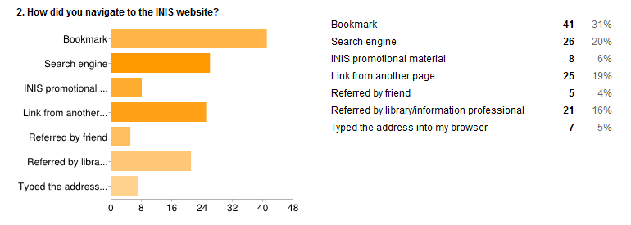
INIS Website User Survey

Slide 9
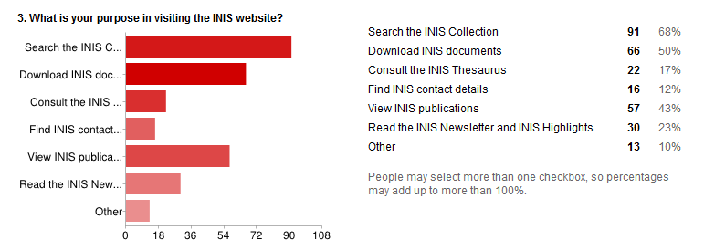
INIS Website User Survey

Slide 10
INIS Website User Survey
4. Rate INIS subject areas according to your interests (%)
 | Below average | Average | Above average | Very high
Nuclear engineering and technology | 5 | 21 | 31 | 35
Nuclear safety and radiation protection | 5 | 23 | 35 | 29
Safeguards and non-proliferation | 12 | 29 | 26 | 16
Nuclear and isotopic techniques | 9 | 29 | 28 | 20
Sciences relevant to nuclear research | 4 | 30 | 30 | 23
Nuclear and high energy physics | 14 | 29 | 29 | 11
Radiation chemistry | 14 | 36 | 20 | 12
Legal aspects of nuclear power | 14 | 32 | 25 | 14
Environment | 9 | 27 | 26 | 26
Economic aspects | 19 | 32 | 18 | 12

Slide 11
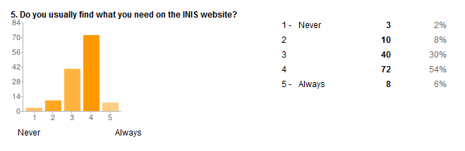
INIS Website User Survey

Slide 12
INIS Website User Survey
6. When using the INIS website, please rate the following (%)
 | Very dissatisfied | Dissatisfied | Neutral | Satisfied | Very satisfied
Ease of use | 4 | 5 | 20 | 54 | 15
Visual appearance | 2 | 2 | 22 | 52 | 19
Organization of information | 1 | 4 | 27 | 50 | 14
Relevancy of information | 0 | 3 | 18 | 49 | 26
Website speed and performance | 1 | 0 | 20 | 48 | 26

Slide 13
INIS Website User Survey
7. What did you find most useful about the INIS website?
INIS collection search
INIS thesaurus
Non-conventional literature and author information
Ease of use
Events
Links to full text technical reports
Nuclear knowledge information
Advanced search option
Possibility to find new documents unavailable in other places.
Very fast, especially when compared to how it used to be
Radiation oncology
Finding documents in full text
Download documents

Slide 14
INIS Website User Survey
8. What did you find least useful about the INIS website?
None
Members area's order form
A command search
Fukushima situation documents collection
Missing "added last week... added last month"
The Google search syntax (use of parenthesis, searching steps, truncation)
Does not go back far enough in years
Only 4% of all searches are using the advanced search option!

Slide 15
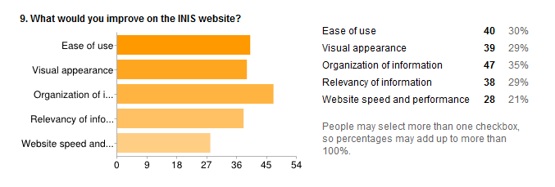
INIS Website User Survey

Slide 16
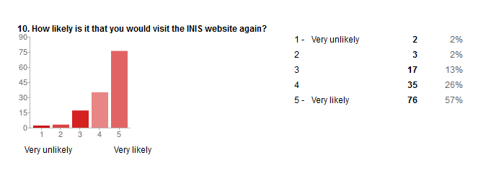
INIS Website User Survey

Slide 17
INIS Website User Survey
11. Which other nuclear information resources/websites/databases do you use?
Energy Citations Database Adams OECD
Yahoo
Google scholar
AAPM
Science Direct
IAEA website
AGORA HINARI OARE
Russian "Proatom“
NTIS
CERN documents
KISS
INSPEC
ANSN
Web of Science
US Deportment of Energy
RRDB
PRIS
IAEA library
ECD EU bookshop
NTIS
WebSPIRS
INSPEC
Chemical Abstracts
Compendex

Slide 18
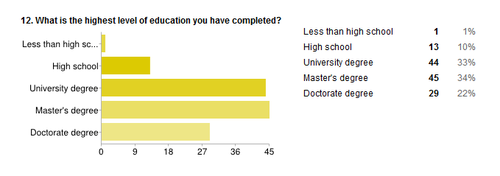
INIS Website User Survey

Slide 19
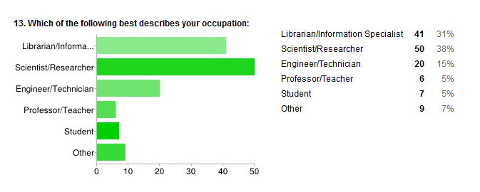
INIS Website User Survey

Slide 20
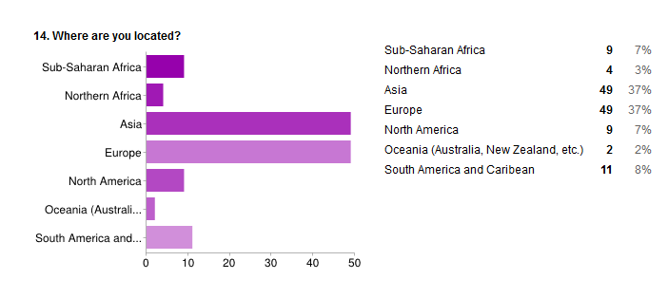
INIS Website User Survey

Slide 21
INIS Website User Survey
15. Other comments or suggestions?
Hyperlink on the authors
Search box - there are two groups - all words or exact phase OR selection of fields. No way to select these two together
Add parenthesis and use of truncation in searches
Useful information to researchers/students
Long Live INIS!
Good luck INIS!

Slide 22
INIS Website User Survey
Thank you!

